Slide 1


Verstehe!
User Training
Web Computing GmbH
Mendelstraße 11
48149 Münster (Germany)
Version 1.0 - As of August 2014

Slide 2
Agenda
1
Product Overview
2
Role & Reputation System
3
Exploring
4
Authoring
5
Editing (ReExploring, Topic Editing, Master Editing)
6
Management (Publishing & Administration)

Slide 3
Value Proposition
Build
collectively,
continously,
efficiently,
open,
sustainable,
scalable,
corporate
knowledge!
user-generated vs editor-generated
permanent vs discrete learning
massively online vs offline
open vs proprietary intellectual asset
long-term vs short-term memory
broad vs small audience
* grey-coloured text represents the current situation in many organizations
Notes:
Umgangssprachliche Definition

Slide 4
Functional Proposition
We
build,
share,
watch,
support,
train
and
know!
topics / films, briefings, trainings, …
quality assured publication
multi-media (videos, documents, …)
multi-media questions and answers
multi-media trainings
Notes:
Umgangssprachliche Definition

Slide 5
Basic Product / Service Definition
Social Knowledge Media System
User- generated, open and
organized!
Quality assured,
clear,
compact and to the point!
Faster understanding and more sustainable
knowledge with video!
All functions integrated in a single system!
Notes:
Internet-orientierte Definition

Slide 6
Enhanced Product / Service Definition
Web-based integrated application system for consuming, authoring, reExploring, editing, publishing and administration of user-generated multi-media knowledge units for exploring, supporting, briefing
and training.
Notes:
Analytische Definition

Slide 7
Functions (Selection)
Authoring Functions
Users can create and share knowledge units (e.g. topic with film) for all users (public) or a dedicated user group (private)
Recording Functions
Screen or webcam and/or hybrid (screen & webcam) recording without technical barriers and training effort
ReExploring Workflow
Workflow for quality assurance of knowledge units before publication (e.g. via ‘Double Blinded Lean Reviews’)
Editing & Publishing Framework Editorial functions for structuring content, controlling and organization of user-driven authoring, reExploring and publication processes
Role System
Clear roles for all aspects of the collective know-ledge building and usage (e.g. master editor, editor, reviewer, author, explorer)
Reputation System
Users can develop their ‘reputation’ with specific tasks around knowledge building;
reputation-based badge & role nominations
Notes:
Herausgeber-Funktionen
Chefredakteur-Funktionen
Fachredakteur-Funktionen
Erweiterte Autor-Funktionen (Dokumenten- und Quelltext-Bereitstellung)
Erweiterte Recording-Funktionen (u.a. Auswahl Mikrofon, Maushervorhebung)
Erweiterte Administrationsfunktionen
Embed-Funktion
Notification-Funktion
Multi-Instanz-Fähigkeit (noch nicht vollautomatisiert)

Slide 8
Technical Functions (Selection)
Zero Client & Zero Configuration Recording
No installation of software on any device;
simply use web browser and Java (already pre- installed in corporate environments)
Multi Device / Mobile Support
Seamless usage of knowledge units (e.g. topics with films) on PC, notebook, tablet und smartphone
Fully automated Film Production
Automated production (e.g. assembling, water-marking, encoding) of films in different resolutions and customizable corporate design
Embedding in Corporate Web Sites
Produced and published films might be embedded in existing corporate intranet sites (e.g. Wikis, Collaboration tools)
Multi Tenancy & Multi Site Capability
Multiple tenants and “knowledge sites” (within a tenant) can be created in order to encapsulate legal entities (tenant) and domains (sites)
Cloud-style Infrastructure Administration
Virtualization, automated deployment, monitoring and other administration as well as scaling options are on board
Notes:
Herausgeber-Funktionen
Chefredakteur-Funktionen
Fachredakteur-Funktionen
Erweiterte Autor-Funktionen (Dokumenten- und Quelltext-Bereitstellung)
Erweiterte Recording-Funktionen (u.a. Auswahl Mikrofon, Maushervorhebung)
Erweiterte Administrationsfunktionen
Embed-Funktion
Notification-Funktion
Multi-Instanz-Fähigkeit (noch nicht vollautomatisiert)

Slide 9
Media
Take: Screen or webcam and/or hybrid (screen and webcam) recording
Film: Contains scenes, intro, outro, section transitions. Each scene is associated with a single take.
Film
contains
Take
Document
is a
is a
Screen Recording
Webcam Recording
Hybrid Recording
Office Document
Image
Source Code

Slide 10
Contribution by Type
Topic: Content container for a single film and/or documents and additional data (e.g. recommendations, source disclosures); topic can be requested („pull“)
Briefing: Brief information in respect to an event / entity etc.; a briefing has a specified allocation group and will be automatically allocated („push“)
Film
Film
Document
uses
may contain
may contain
Training
Playlist
Briefing
Q&A
Topic Request
Film
Film
Film
Doc
Doc
kann enthalten
Quiz
Doc

Slide 11
Taxonomy
Taxonomy: Classification system for knowledge contributions (e.g. topics with films, playlists, trainings)
Topic World 1st Level
may contain
may contain
Topic World 2nd Level
Topic Area
Topic World 3rd Level
Topic Area
Topic
...*
Topic Area
Topic
...*
Topic
...*
* e.g. Playlist, Briefing, Training, Q&A, Topic Request

Slide 12
Process „Create and Publish Topic with Film“
1
2
3
4
5
Create a topic with a screenplay
Create a screen or
webcam or
hybrid recording (Take)
Your Takes
will be
produced
automatically to a film
Optional:
Your Film will be reviewed
Your Film will be published
Metaphor: Movie Business

Slide 13
Roles
User: Represents a person
Role: Allocation of privileges for a set of actions
A user can have several roles
A role can be associated with multiple users
Role Structure: Higher roles additionally contain the privileges of lower roles
Publisher
Master Editor
Create Verstehe! sites
Nominate master editors
Set functional parameter values
Topic Editor
Create taxonomy
Create landing pages
Nominate master and topic editors
Control of publication processes
Reviewer
Create topic areas
Maintain landing pages
Create trainings
Create badge models
Author
Review topics with films
Explorer
Create topics with films
Create playlists
Search contributions
Watch/study contributions

Slide 14
Reputation
User goals: Build own expertise and/or contribute to build expertise of other users
Reputation: Representation of expertise building and contribution
Reputation
is measured by
is expressed by
is an aggregation of
Reputation Score
Badges
Reputation Points
are confered by
are allocated by
Reputation Rule
Reputation Event
Badge Event
Badge
Rule
is a
is a
Create Topic/Film
Complete Training
Answer Question
...

Slide 15







Badges
Badges: Micro certificates. Users will be nominated for badges for a specific set of contributions. Competencies / expertise of an user will be transparent by badges.
Contribution Achieve- Type ment Level | Explore | Train | Support | Author | Edit
1. Participation | Explorer | Certificate@ [Introductory Tr.] | Supporter | Author | Topic Editor
2. Bronze | Active Explorer | Certificate@ [Core Training] | Active Supporter | Active Author | Active Topic Editor
3. Silver | Good Explorer | Certificate@ [Advanced Train.] | Good Supporter | Good Author | Good Topic Editor
4. Gold | Top Explorer | Certificate@ [Expert Training] | Top Supporter | Top Author | Top Topic Editor
5. Platinum | Expert@[Topic Area]
6. Diamond | Master@[Topic World]
7. Rarely | Eminent Authority@[Topic World]

Slide 16
Tenant
Tenant: Ordering unit of the application system in order to encapsulate the data / content and allocate access privileges
Usually a tenant will be created for each legal entity (e.g. XYZ AG).
Access privileges will be granted only to the users of the legal entity. An user can not access data / content from foreign tenants.
System
Tenant „XYZ AG“
Tenant „ABC GmbH“
…
Employee XYZ AG
Employee ABC GmbH

Slide 17
Sites
Site: Website which encapsulate data / content for different purposes and / or target groups
Additional websites can be added within a tenant.
Each website can be allocated with an „Access Control List“.
https://verstehe.info/tenant
…
Tenant-specific sites overview
Site
https://verstehe.info/tenant/siteX
…
…
…
…
…
Site 1
Site 2
Site 3
Site 4
e.g. for a functional domain of the corporation
e.g. for a project of the corporation
e.g. for an organizational unit of the corporation
e.g. for an system of the corporation

Slide 18
System
System: System of multiple application systems
Web-based frontend application systems for usage with a browser, also for mobile devices
Backend application systems for background processing jobs
PC
Notebook
Tablet
Smartphone
Frontend
Portal
Management
Administration
use
Backend
Filmproduktion
Recommendation engine (content)*
Infrastructure Administration*
*Alpha (not included in release)

Slide 19
Agenda
1
Product Overview
2
Role & Reputation System
3
Exploring
4
Authoring
5
Editing (ReExploring, Topic Editing, Master Editing)
6
Management (Publishing & Administration)

Slide 20
Role & Reputation System – Models & Interfaces
Role System
Reputation System
Task Model
Badge Model
Scoring Model
Privilege Model
Task Model - Purpose: Competence-based allocation of tasks
Privilege Model - Purpose: Role-specific entitlements in conformance to the tasks associated with the role
Badge Model - Purpose: Declaration of achievements respective expertise; motivation for participation
Scoring Model - Purpose: Booking system for fine granular contribution events; declaration of achieved expertise

Slide 21
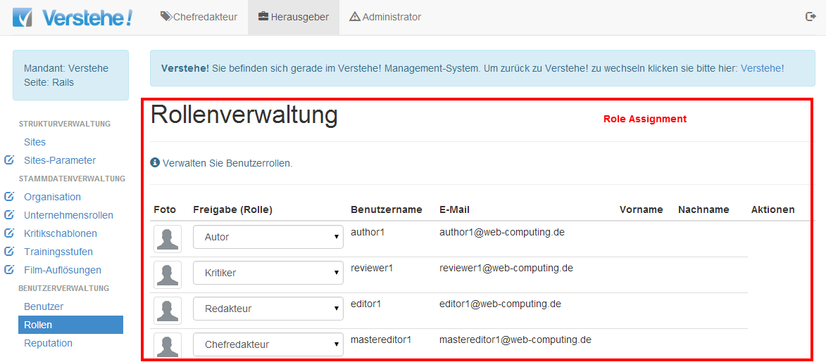
Role System – Role Assignment (Example)

Slide 22
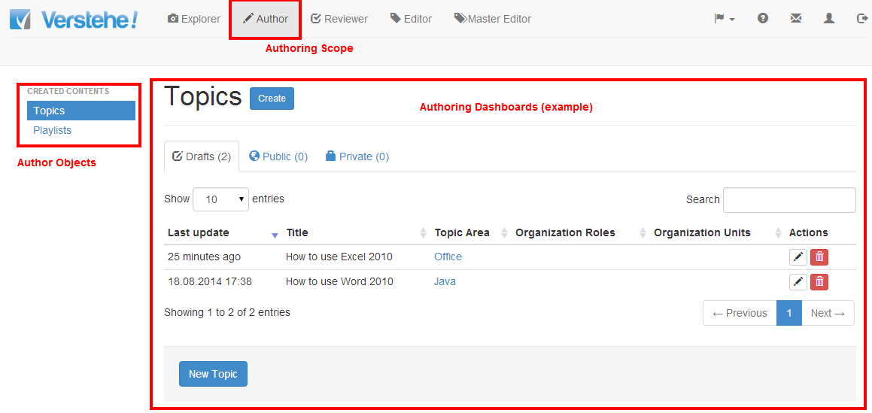
Role System – Author (Example)

Slide 23
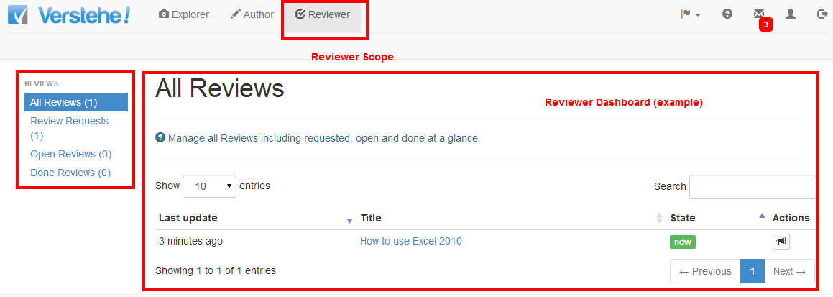
Role System – Reviewer (Example)

Slide 24
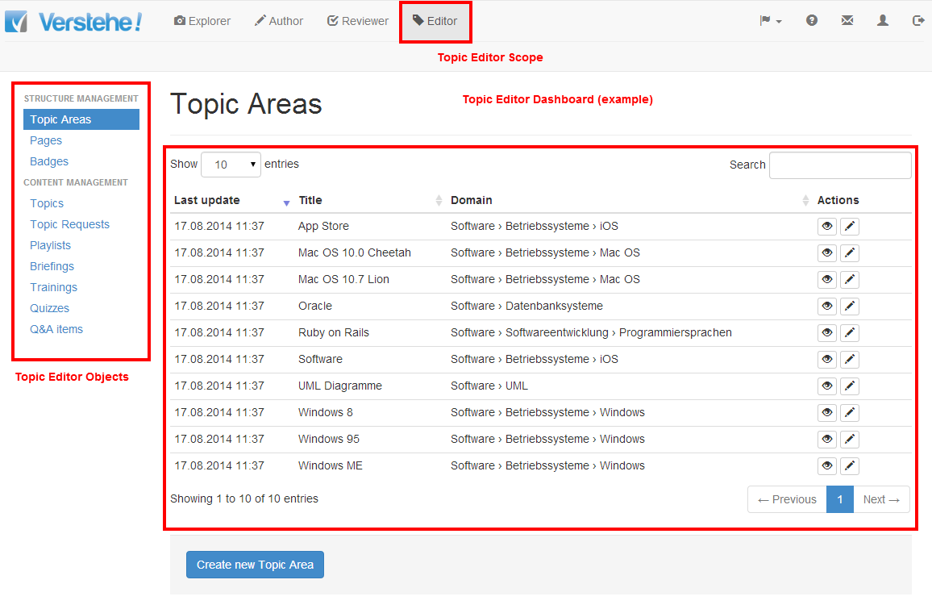
Role System – Topic Editor (Example)

Slide 25
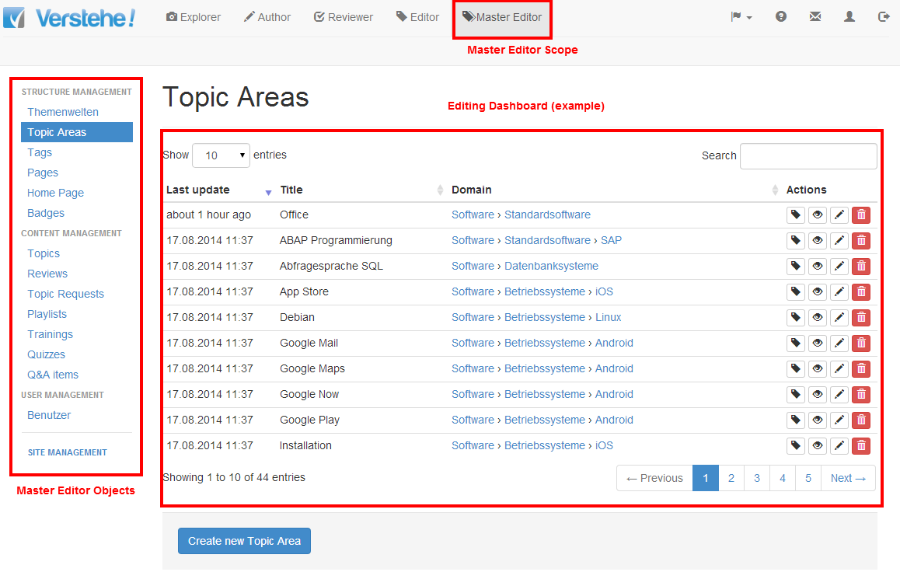
Role System – Master Editor (Example)

Slide 26
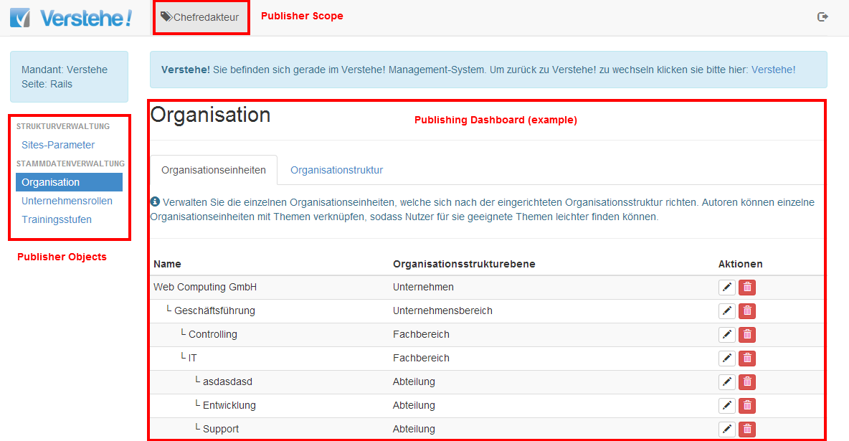
Role System – Publisher (Example)

Slide 27
Role & Reputation System – Models & Interfaces
Role System
Reputation System
Task Model
Badge Model
Scoring Model
Privilege Model
Task Model - Purpose: Competence-based allocation of tasks
Privilege Model - Purpose: Role-specific entitlements in conformance to the tasks associated with the role
Badge Model - Purpose: Declaration of achievements respective expertise; motivation for participation
Scoring Model - Purpose: Booking system for fine granular contribution events; declaration of achieved expertise

Slide 28
Reputation System - Functions
Badge Model: User can be nominated a badge for defined achievements. Badges will be defined by editors on basis of badge rules. Badge rules are based on events. The badges will be nominated automatically on basis of the badge rules
Badge template definition (master & topic editor), incl. Badge nomination rules
Badge nominations (runtime, event-driven, automatic)
„Expertise Dashbord“ (user role) with nominated Badges
Scoring Model: User earn reputation points in case of defined events. Reputation points bookings are baked by reputation rules. Reputation rules cover quantity (e.g. „Views Count“) and quality (e.g. „Like Ratio“) of contributions. Example of events are: Publishing of a Topic / Film, Review of a Topic / Film, Publishing of Trainings / Quizz, Answer a Question
Reputation account & score
Reputation points allocation rules
Reputation points bookings
„Expertise Dashbord“ (user role) with historic & actual Reputation Scores & Bookings
Notes:
Alle angeführten Prinzipien sind Erfolgsmodelle!

Slide 29
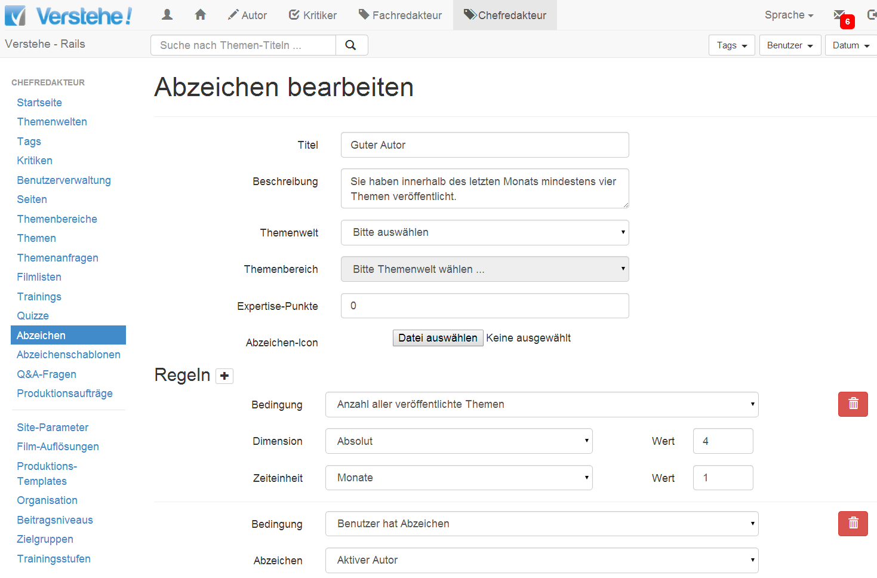
Reputation System – Badge Model (Example)
Definition of Badges
Badge Meta Data
Badge Icon
Badge
Rule

Slide 30
Agenda
1
Product Overview
2
Role & Reputation System
3
Exploring
4
Authoring
5
Editing (ReExploring, Topic Editing, Master Editing)
6
Management (Publishing & Administration)

Slide 31
Exploring – Functional Aspects
Notes:
Common Page View: Home & Landing Pages
Search: Optionen für die Suche
Individual Page View: Historie der aufgerufenen Wissenseinheiten
Unit View: Einzelansicht von Wissenseinheiten (z.B. Themen/Film, Playlist, Training, Fragen & Antworten)

Slide 32
Exploring – Functions: Common Page View
Domain Landing Pages: Übersichtsseite zu der Themenwelt (Standard & Blog Style)
Topic Area Landing Pages: Übersichtsseite zu dem Themenbereich (Standard & Blog Style)
Knowledge Object Type Landing Pages: Umgekehrt chronologisch sortierte Liste (Blog Style) für z.B. Filme, Playlist, Themenanfragen, Fragen & Antworten
Topic Listings: Sortierte Listen nach Neuigkeit, Beliebtheit und Redaktionsempfehlung

Slide 33
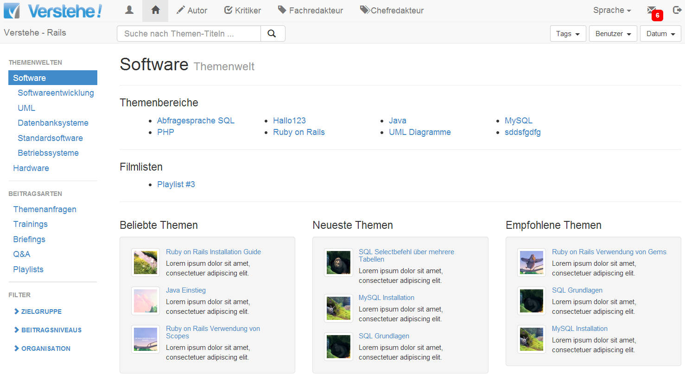
Exploring – Functions: Common Page View (Example)
Domain Landing Page
Topic Listings
Knowledge
Object
Types

Slide 34
Exploring – Functions: Search
Taxonomy Search: Search in the classification tree
Drill-down: Topic World 1st level → Topic World 2nd level → Topic World 3rd level → Topic Area → Topic
Roll-up: Topic Area → Topic World 3rd level → Topic World 2nd level → …
Fulltext Search: Search search term in all contributions
Type Search: Search by the contribution type (e.g. Topics, Playlists, Trainings, Briefings, Questions & Answers)
Global Content Filter: Filtering of contributions by the target group which is composed by:
Enterprise Role: e.g. cost controlling manager, cost controlling specialist, cost controlling agent, risk controlling manager, …
Organisational Unit: e.g. division, departements, teams, …
Local Content Filter: Temporal filtering of contributions by
Tags: meta data of an contribution in order to classify the functional area
Authors: authors of topics/films
Publication date: e.g. last month, last week, …

Slide 35
Exploring – Functions: Search (Example)
Fulltext Search
Taxonomy Search
Local Content Filter
Type Search
Global Content Filter

Slide 36
Exploring – Functions: Unit Views
Topics (Container for Film, Documents, additional Data):
View/Vote/Comment Films (Video Streaming)
View/Vote/Comment Documents
Playlists: View/Vote/Comment Actions
Briefings: View/Vote/Comment Actions
Trainings (incl. Quizzes): View/Work Actions
Topic Requests: Create/Read/Update/Delete
Question & Answers: Create/Read/Update/Delete

Slide 37
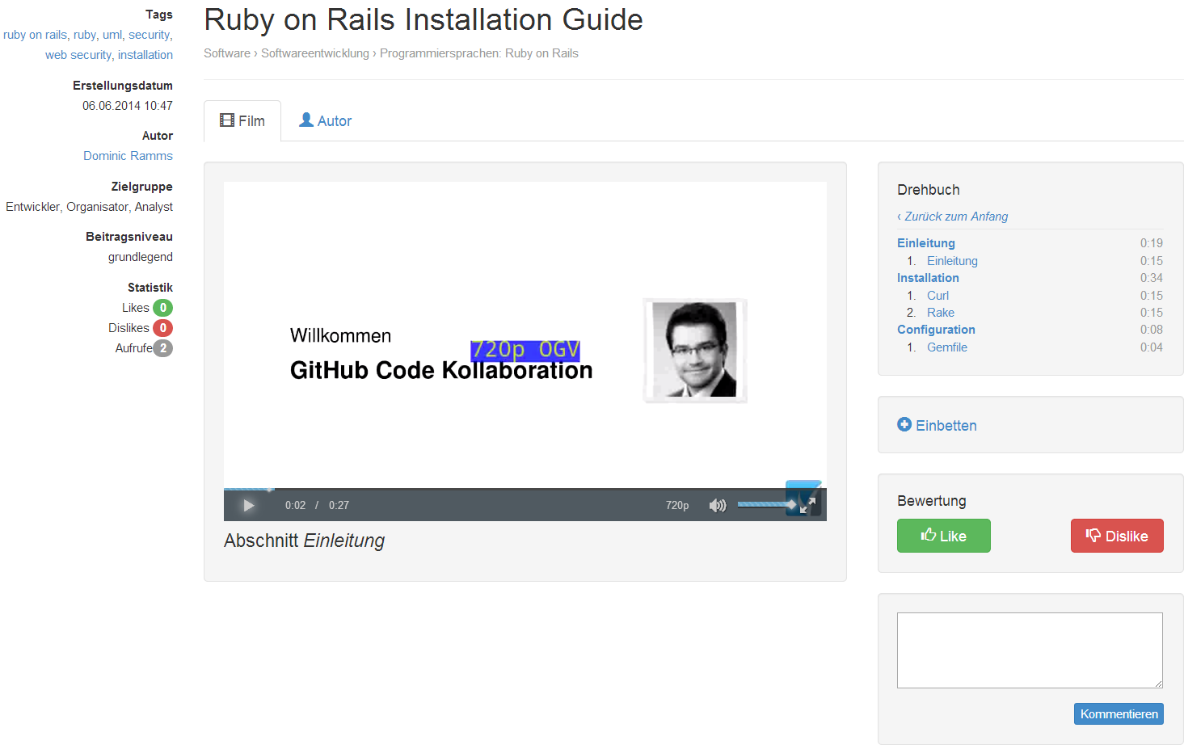
Exploring – Functions: Unit Views (Example)
Media Player
Screenplay („Drehbuch“)
Unit Meta Data
Embed
Voting
User Comments

Slide 38
Exploring – Functions: Individual Page View
My Content: Dashboards
Topic Dashboard
Film Dashboard (incl. Play Status)
Document Dashboard
Training Dashboard (incl. Work Status)
Briefing Dashboard
Account: Read/Update/Delete Actions
Messages: Create/Read/Update/Delete Messages (in / out)
Abonnements: Dashboard, Create/Read/Update/Delete Actions
Reputation: Dashboard, Read (Badges, Reputation Scores) Actions

Slide 39
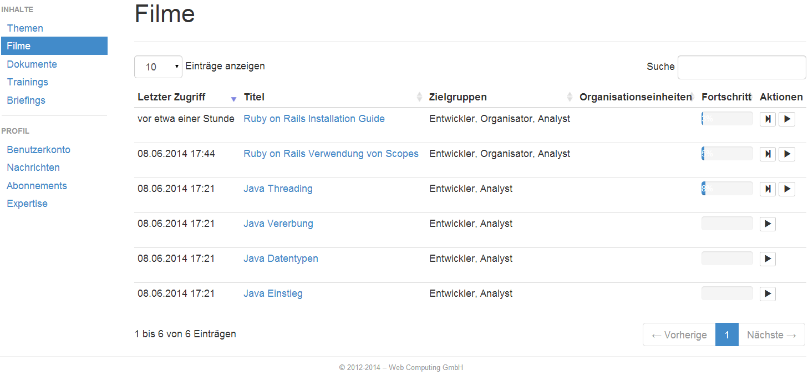
Exploring – Functions: Individual Page View (Example)
Film Dashboard
Field Filter
Play Status
User Profile & Messaging

Slide 40
Exploring – Functions: General
User Registration
User Authentication: Login / Logoff Actions
Multi-Language: Switch Actions (german, englisch)

Slide 41
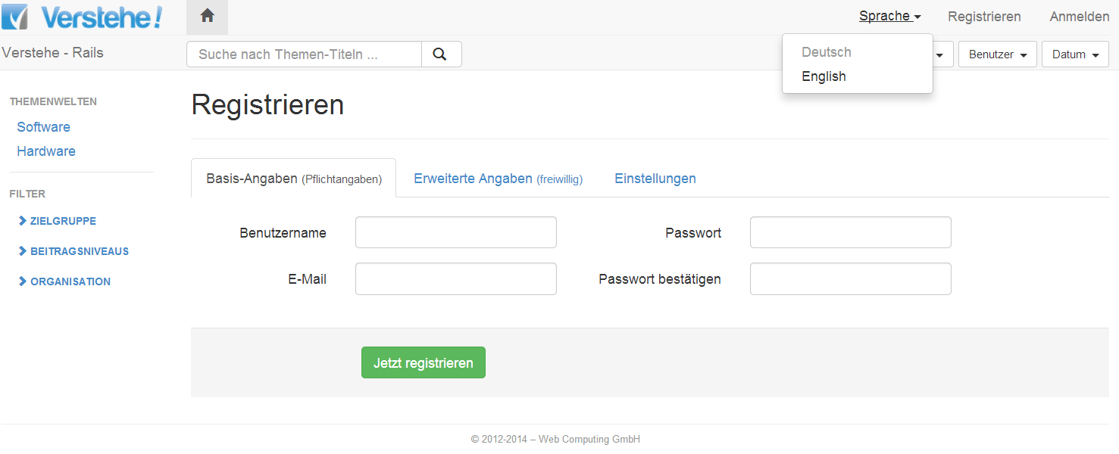
Exploring – Functions: General (Example)
Multi-Language Switch
Login
User Registration

Slide 42
Agenda
1
Product Overview
2
Role & Reputation System
3
Exploring
4
Authoring
5
Editing (ReExploring, Topic Editing, Master Editing)
6
Management (Publishing & Administration)

Slide 43
Authoring – Functional Aspects

Slide 44
Authoring – Functions: Topic Authoring
Topic Meta Data: Create/Read/Update/Delete
Film Screenplay: Create/Read/Update/Delete
Film Direction („Regie“): Decide which Take will be an Scene; assemble Scenes to Film
Topic Documents: Declare & Upload
Topic Code Snippets: Declare & Upload
Topic Recommendations: Create/Read/Update/Delete
Topic Sources: Create/Read/Update/Delete
Topic Frequently Asked Questions: Create/Read/Update/Delete
Topic Change History: Read/Update
Topic Public Publishing: one-to-many, review workflow will be started afterwards
Topic Private Publishing: one-to-one, topics will be published privately for definied users

Slide 45
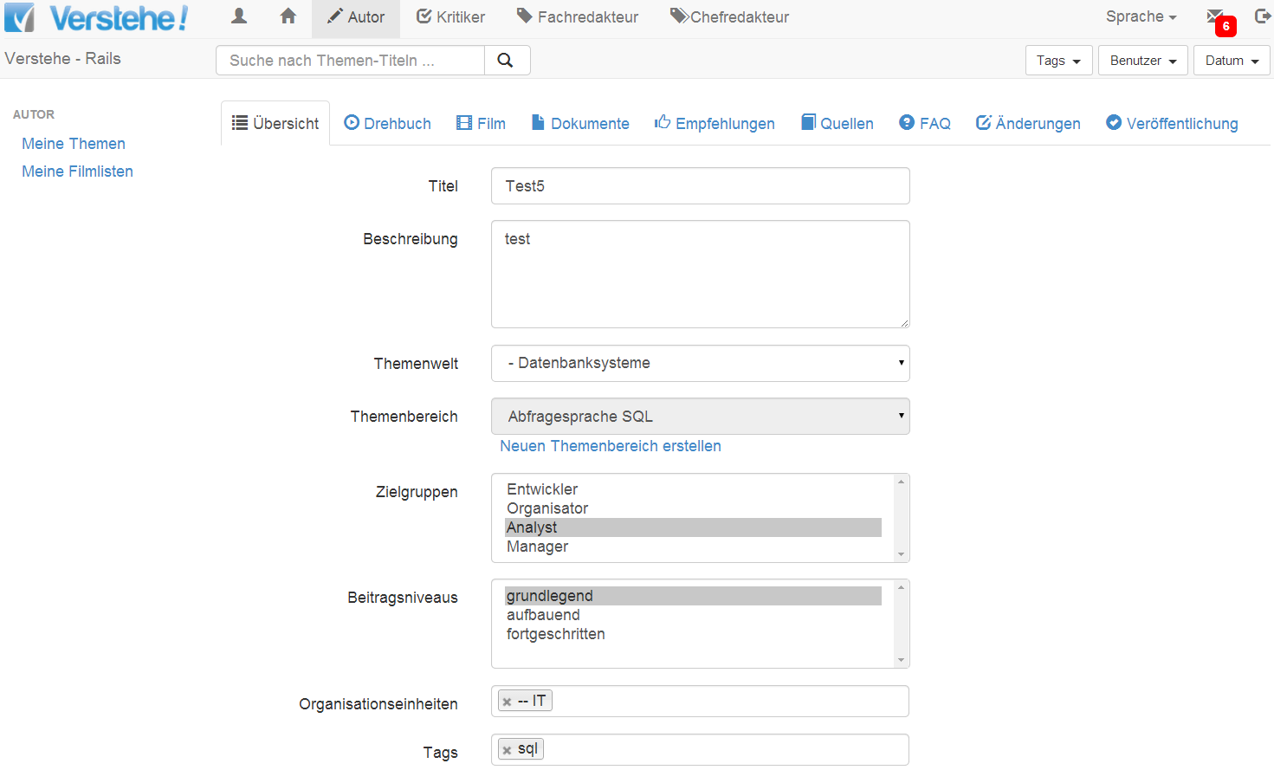
Authoring – Functions: Topic Authoring (Example)
Topic Meta Data

Slide 46
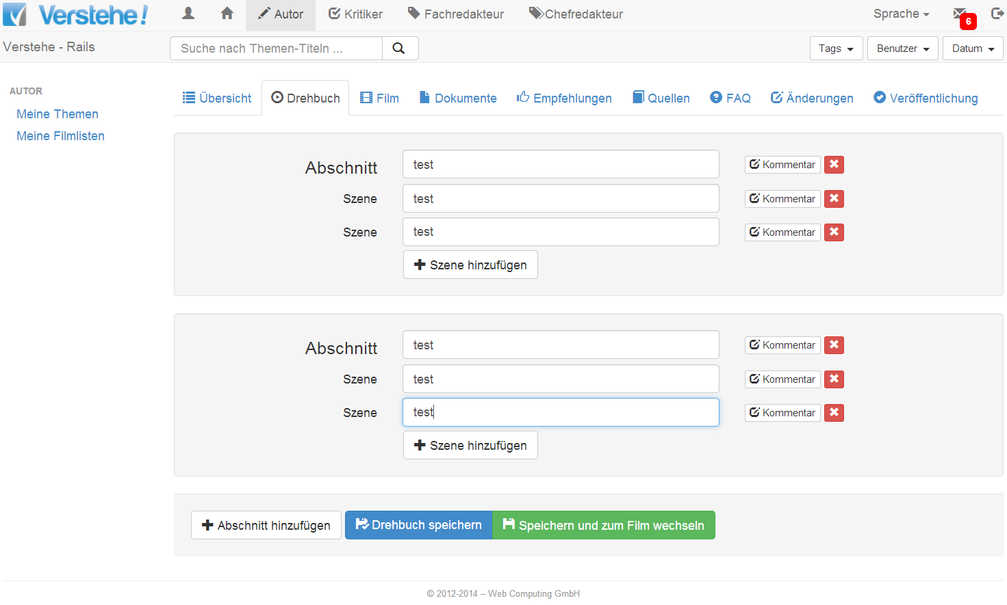
Authoring – Functions: Topic Authoring (Example)
Film Screenplay

Slide 47
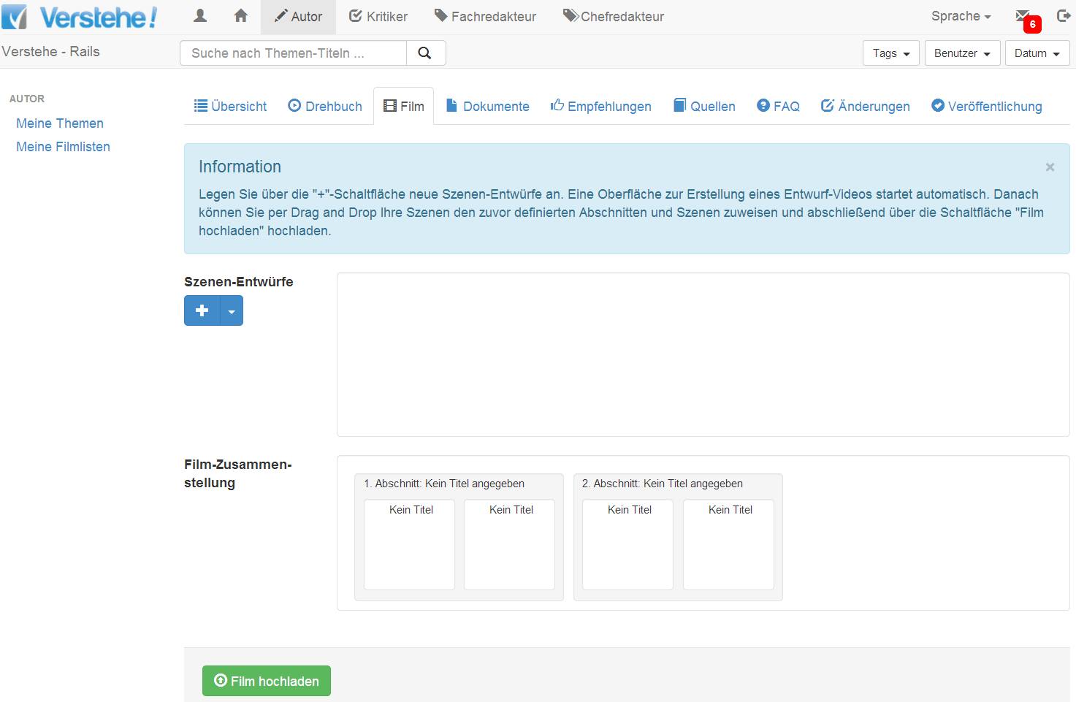
Authoring – Functions: Topic Authoring (Example)
Film Direction („Regie“)

Slide 48
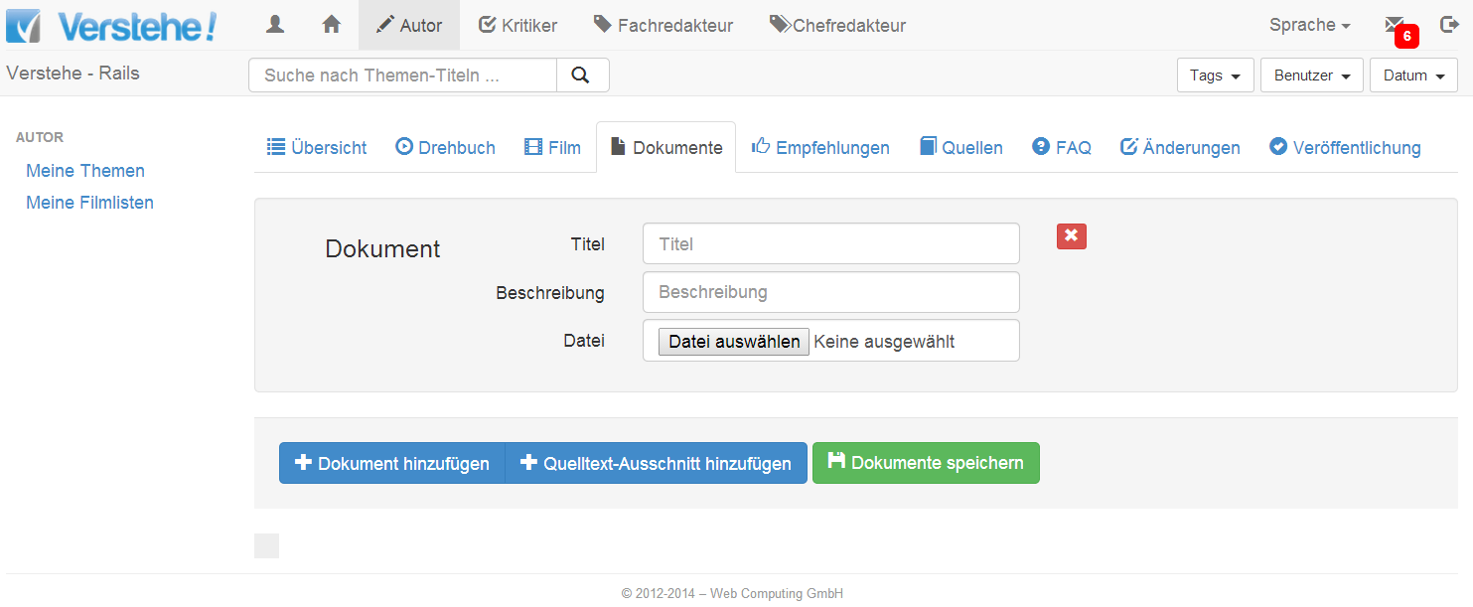
Authoring – Functions: Topic Authoring (Example)
Topic
Documents

Slide 49
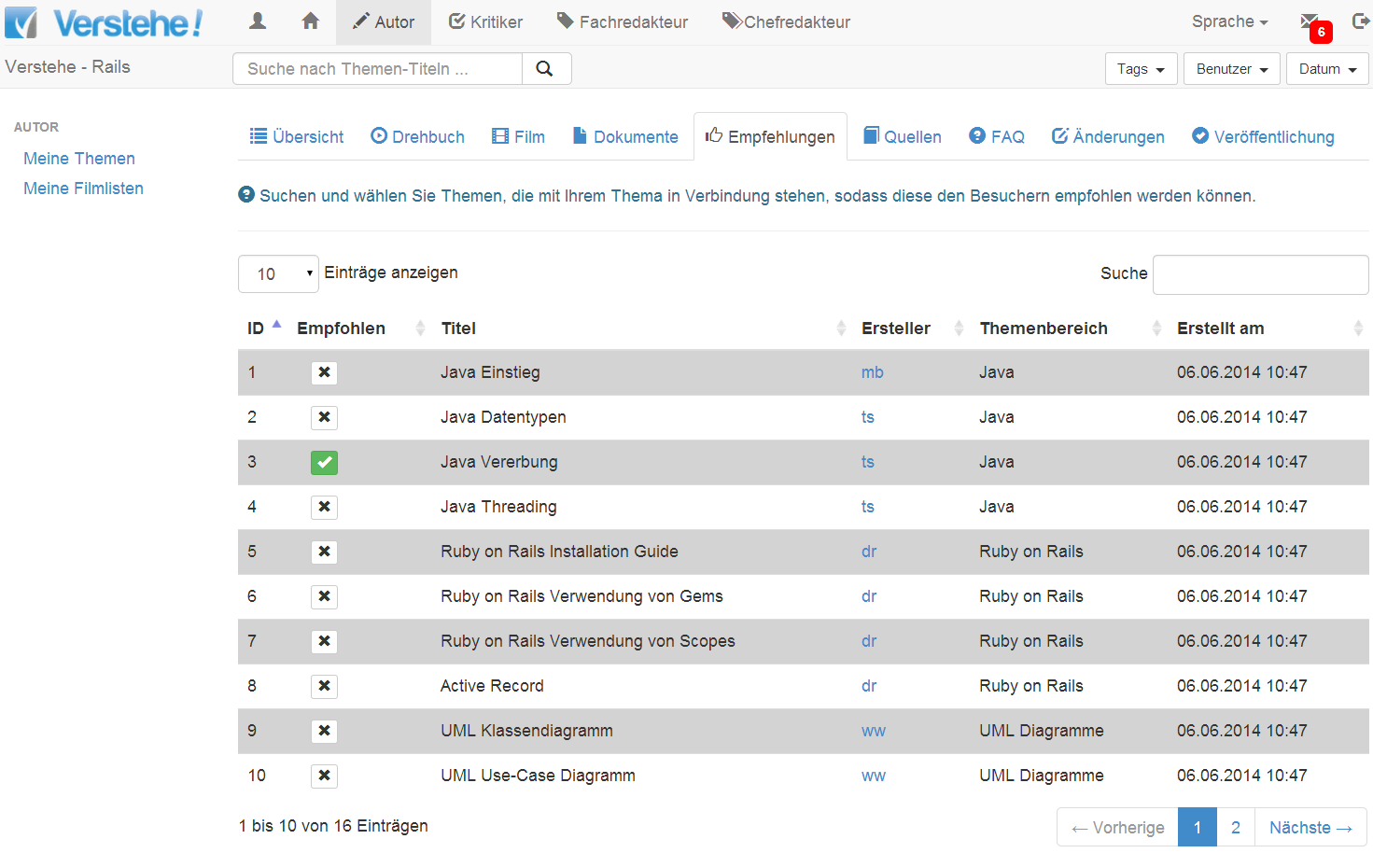
Authoring – Functions: Topic Authoring (Example)
Topic Recommendations

Slide 50
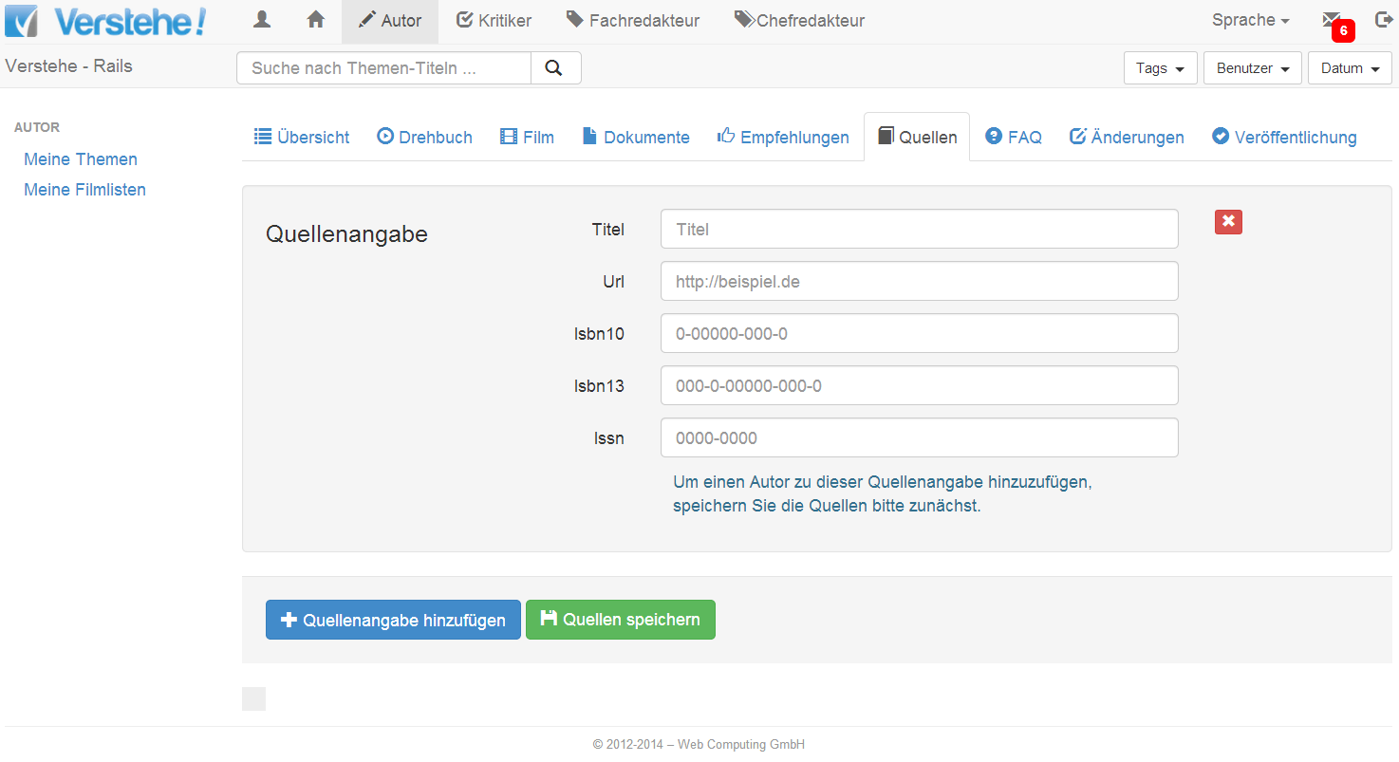
Authoring – Functions: Topic Authoring (Example)
Topic Sources

Slide 51
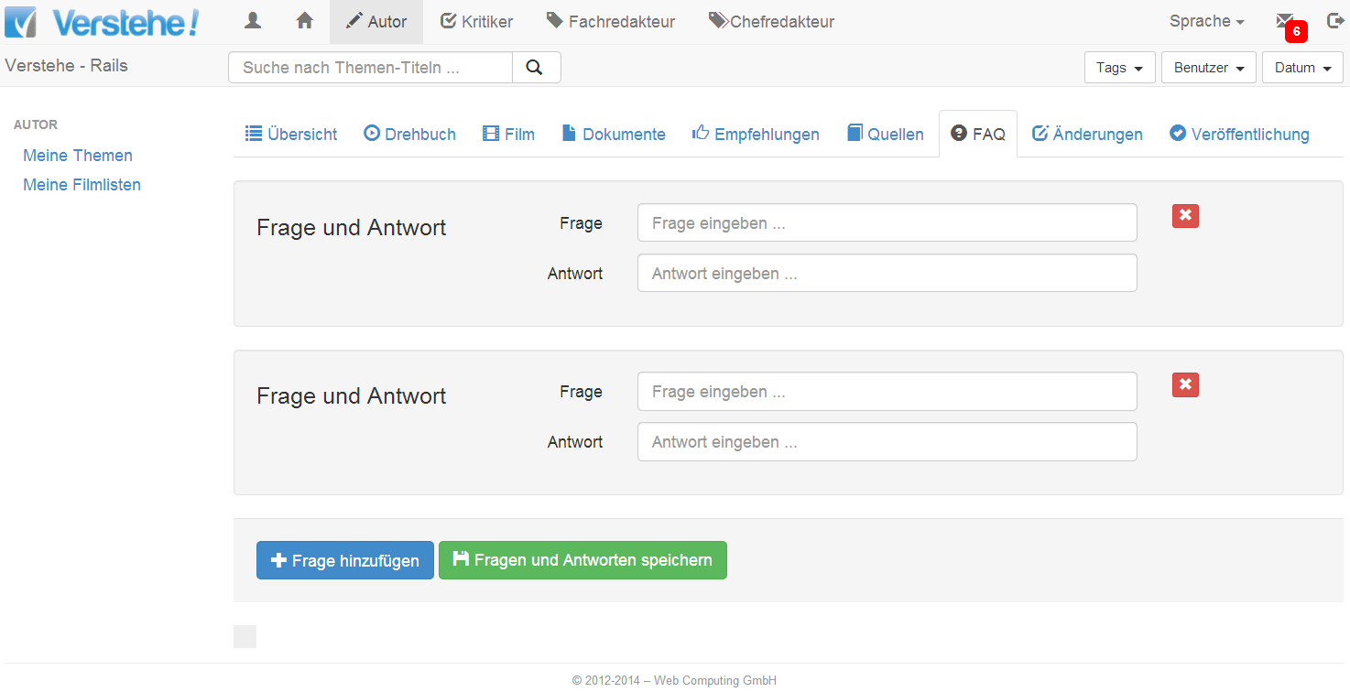
Authoring – Functions: Topic Authoring (Example)
Frequently Asked Questions related to the Topic

Slide 52
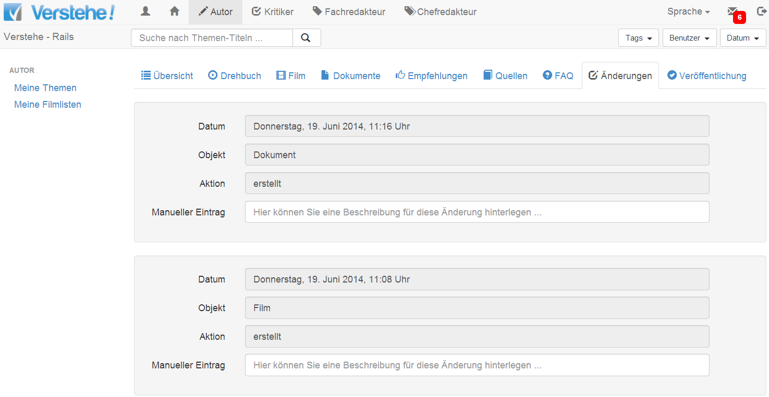
Authoring – Functions: Topic Authoring (Example)
Change History

Slide 53
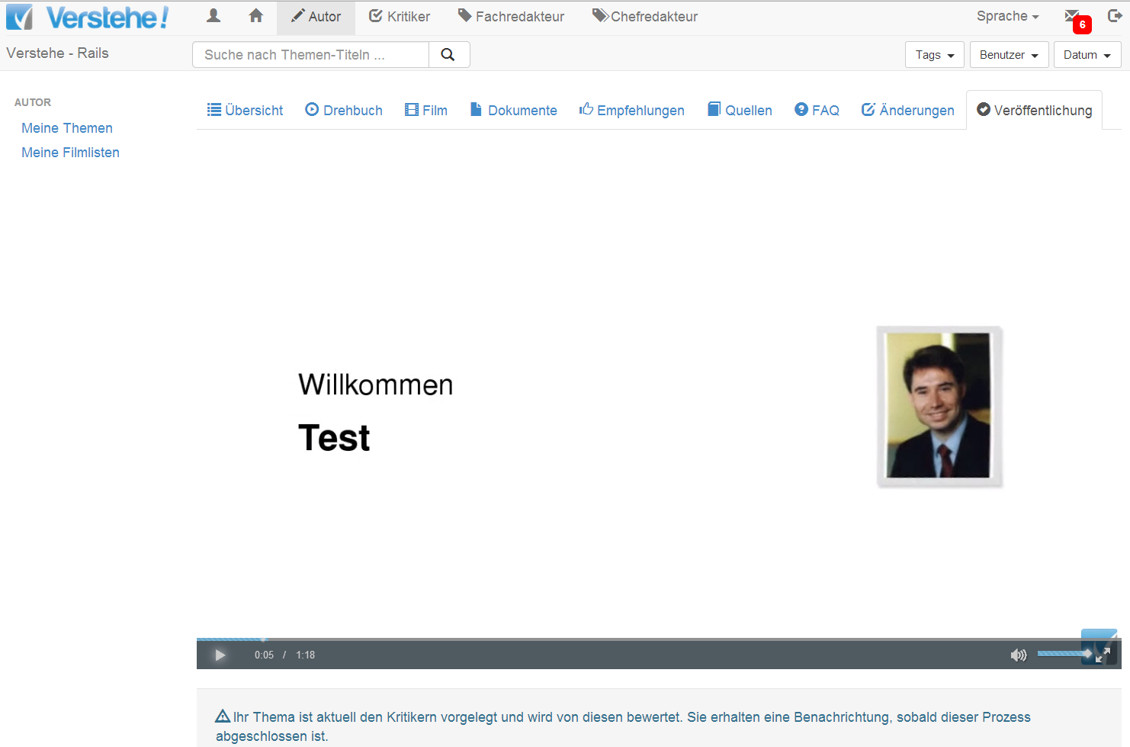
Authoring – Functions: Topic Authoring (Example)
Submit Topic Candidate to Review

Slide 54
Authoring – Functions: Video Recording & Uploading
Screen Recording (Screencast): Create / Delete Actions
Webcam Recording: Create / Delete Actions
Hybrid Recording (Screen & Webcam Recording): Create / Delete Actions
Recorded Video Uploading: Upload Actions
External Video Uploading: File Picking / Upload Actions

Slide 55
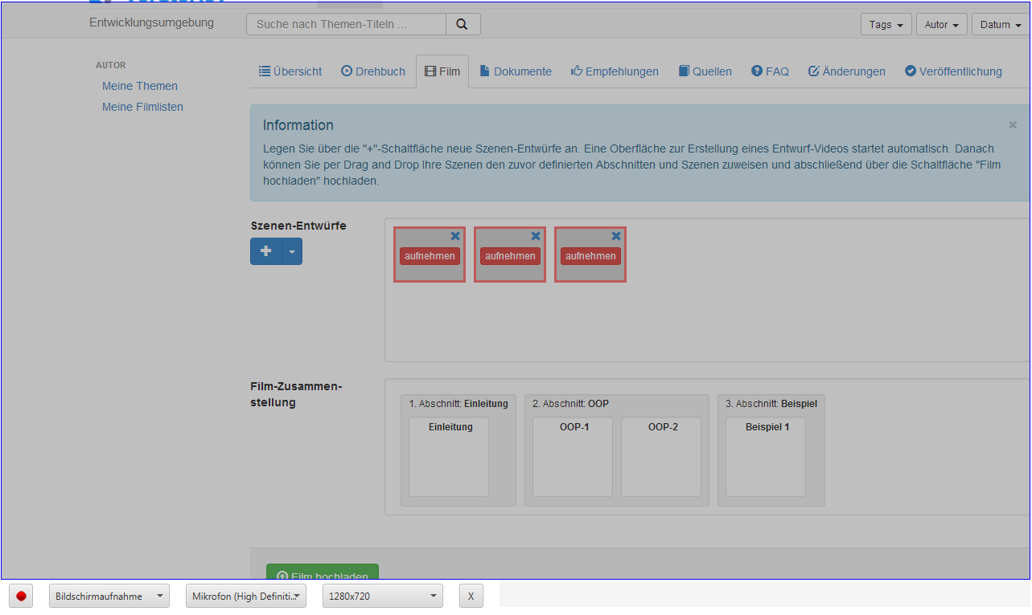
Authoring – Functions: Video Recording (Example)

Slide 56
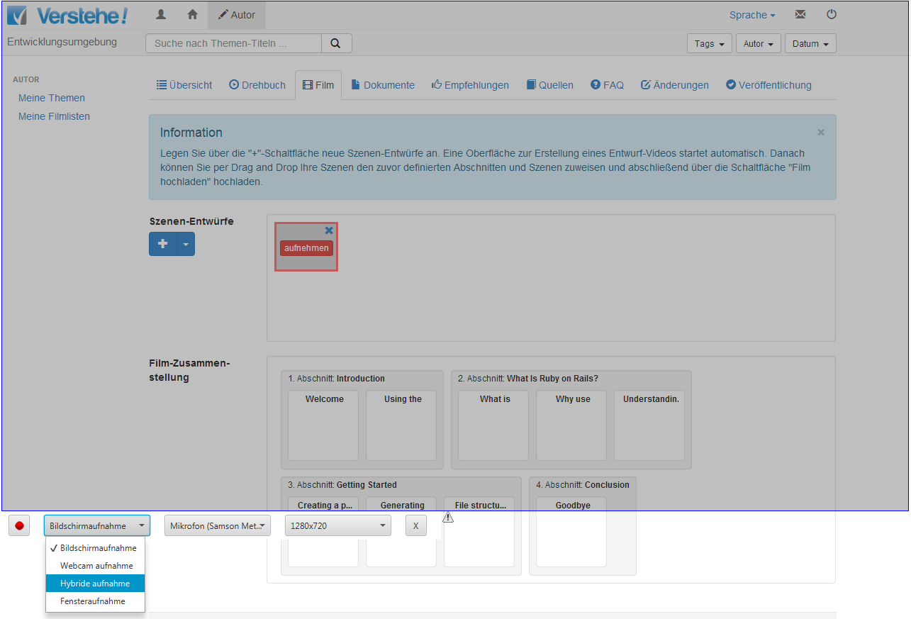
Kernfunktionen - Recording

Slide 57
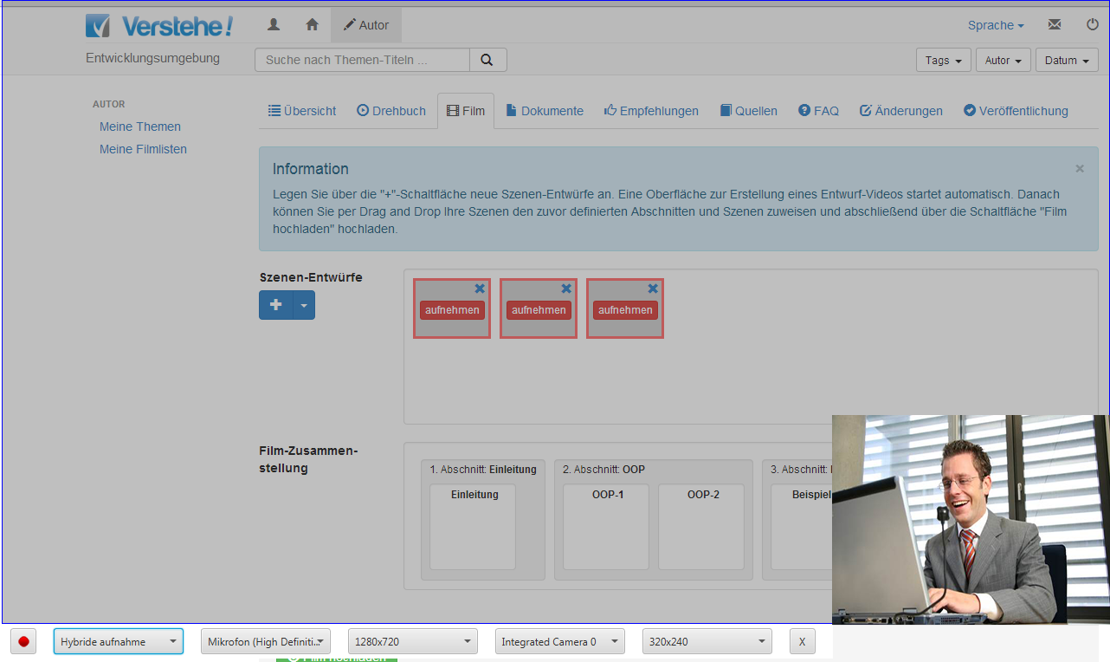
Authoring – Functions: Video Recording (Example)

Slide 58
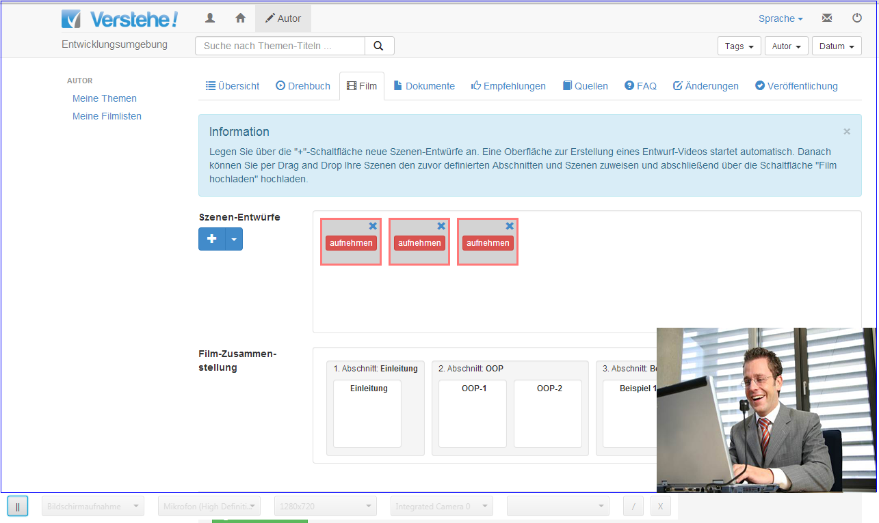
Authoring – Functions: Video Recording (Example)

Slide 59
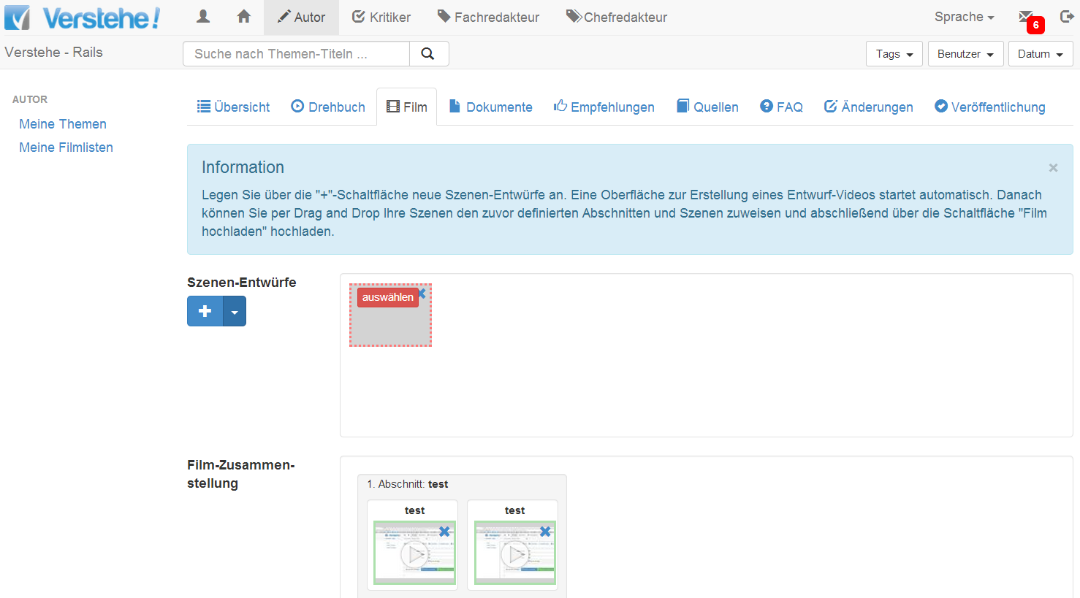
Authoring – Functions: Video Recording (Example)
External Video Uploading

Slide 60
Agenda
1
Product Overview
2
Role & Reputation System
3
Exploring
4
Authoring
5
Editing (ReExploring, Topic Editing, Master Editing)
6
Management (Publishing & Administration)

Slide 61
Editing – Functional Aspects

Slide 62
Editing – Functions: Reviewing
Review Dashboard: Read Review Requests, Open Reviews, Closed Reviews
Review Workflow:
Single Blinded / Transparent
Double Blinded / Transparent
No Review
Review Form:
Scene Review
Aspect Review
Overall Review
Review Schema: Dashboard, Create/Read/Update/Delete Actions

Slide 63
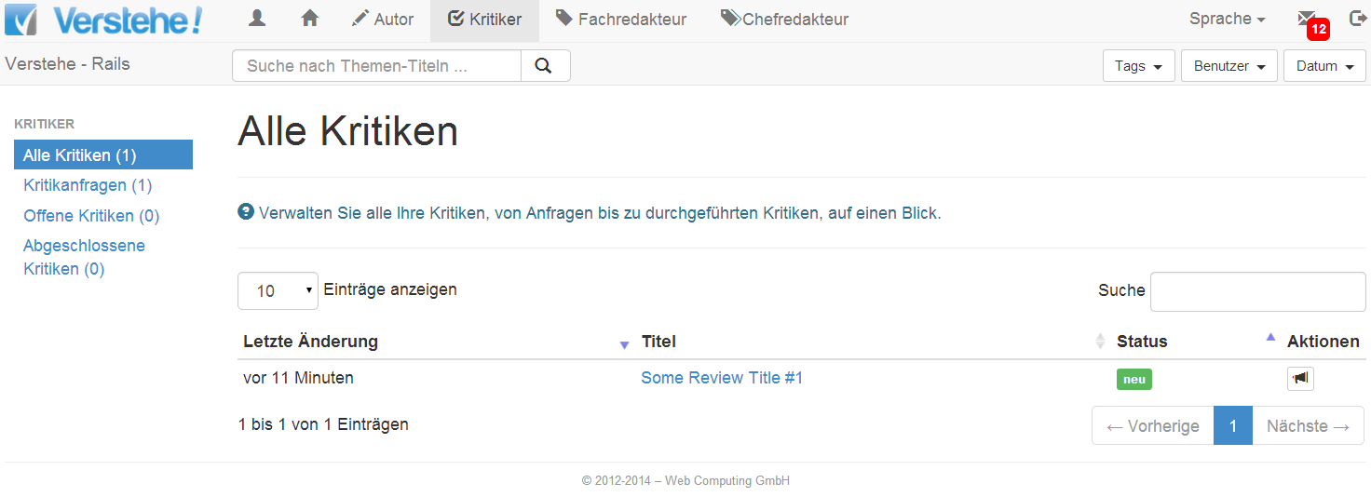
Editing – Functions: Reviewing (Example)
Reviewing Dashborad

Slide 64
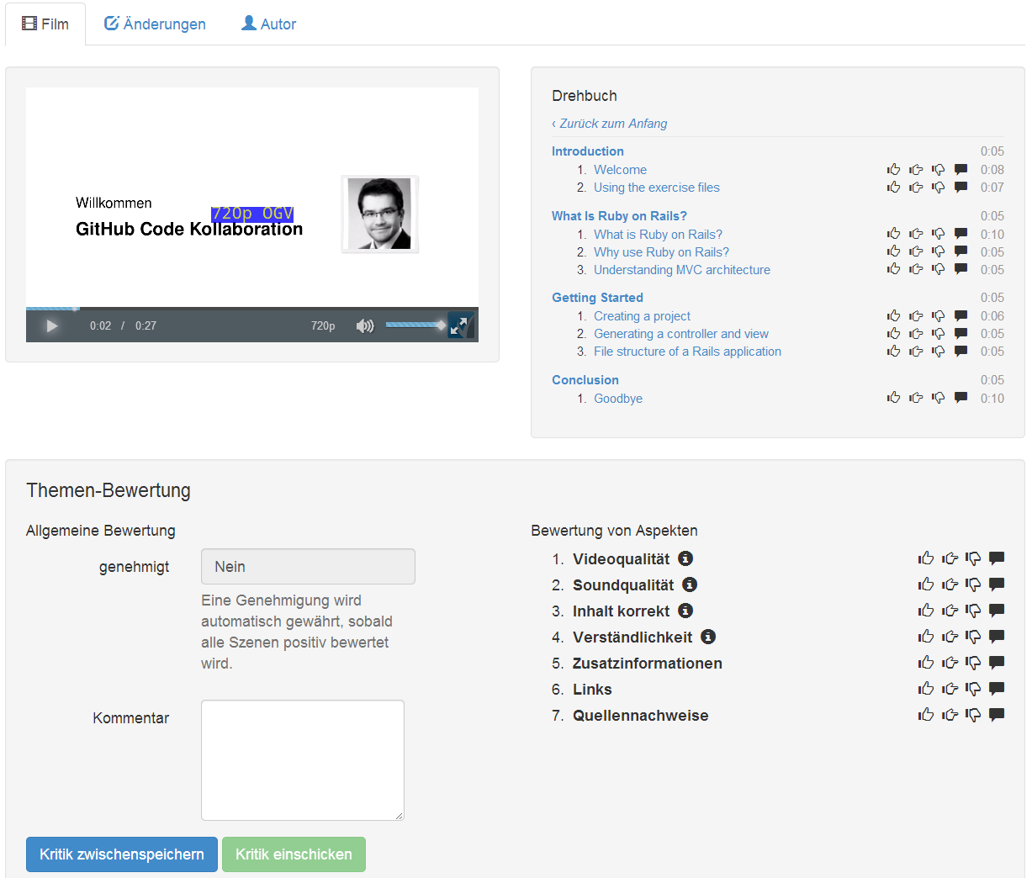
Editing – Functions: Reviewing (Example)
Scene Evaluation
Overall Evaluation
Aspect Evaluation

Slide 65
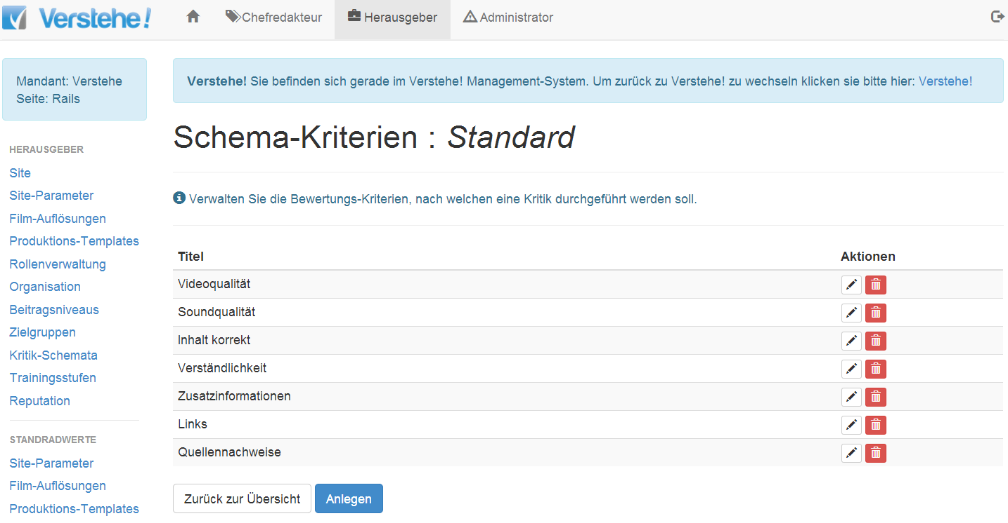
Editing – Functions: Reviewing (Example)
Review Schema

Slide 66
Editing – Functions: Topic Editing
Pages: Dashboard, Create/Read/Update/Delete Actions
Topic Areas: Dashboard, Create/Read/Update/Delete Actions
Topics: Dasboard, Create/Read/Update/Delete Actions (see Authoring)
Topic Requests: Dashboard, Create/Read/Update/Delete Actions
Playlists: Dashboard, Create/Read/Update/Delete Actions
Trainings: Dashboard, Create/Read/Update/Delete Actions
Quizzes: Dashboard, Create/Read/Update/Delete Actions
Briefings: Dashboard, Create/Read/Update/Delete Actions
Question & Answers: Dashboard, Create/Read/Update/Delete Actions
Badges: Dashboard, Create/Read/Update/Delete Actions

Slide 67
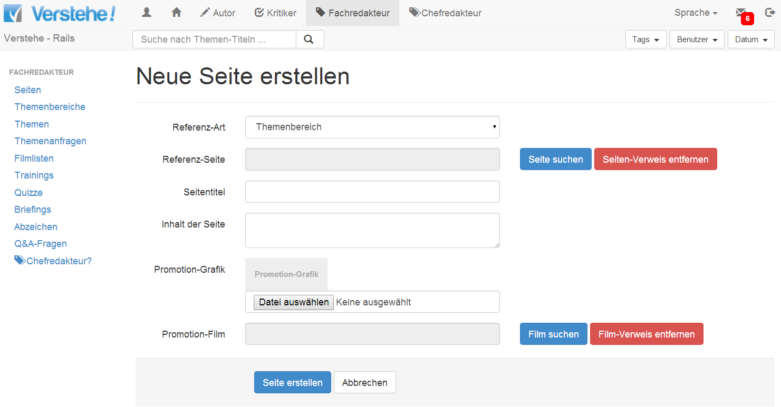
Editing – Functions: Topic Editing (Example)
Pages

Slide 68
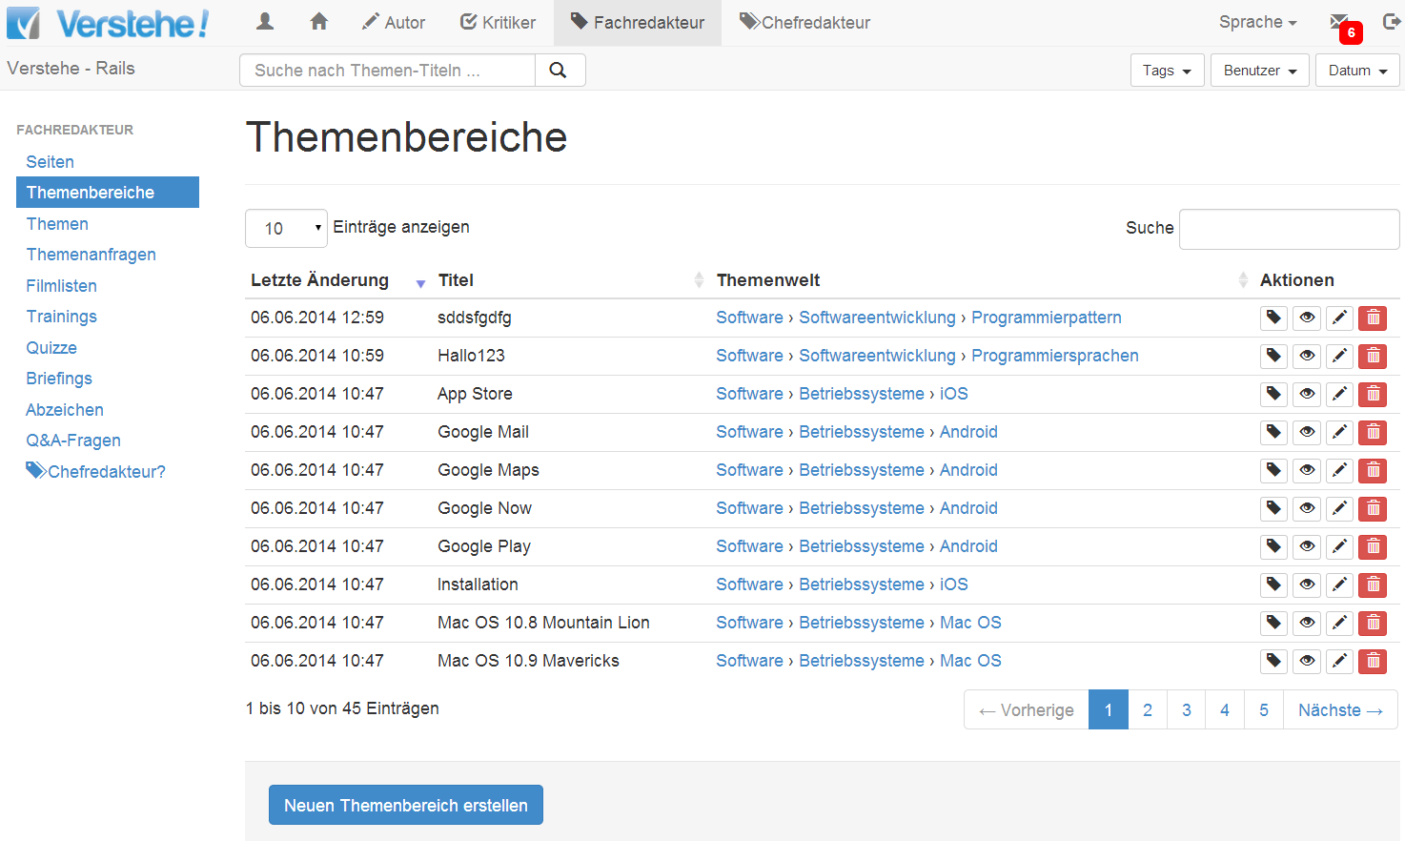
Editing – Functions: Topic Editing (Example)
Topic Areas

Slide 69
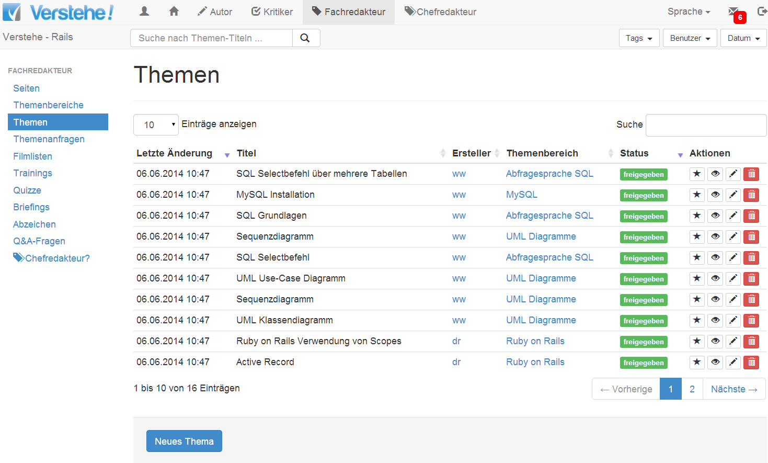
Editing – Functions: Topic Editing (Example)
Topics

Slide 70
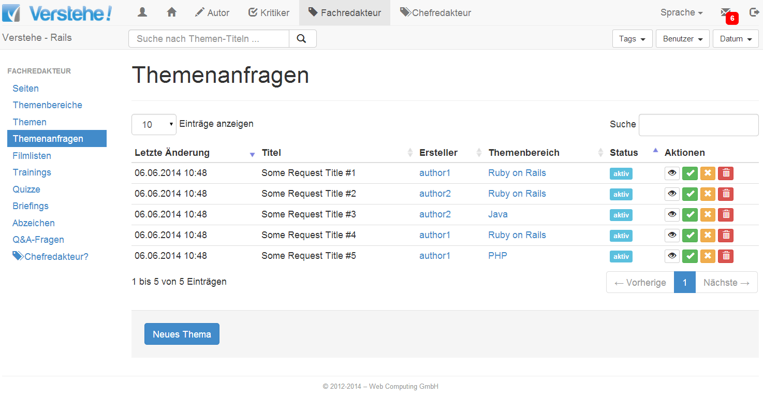
Editing – Functions: Topic Editing (Example)
Topic Requests

Slide 71
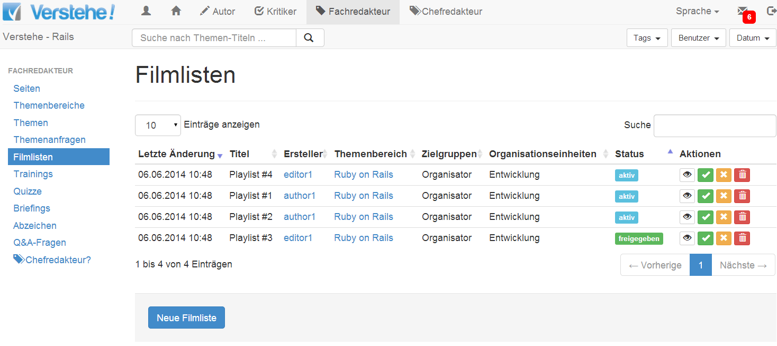
Editing – Functions: Topic Editing (Example)
Playlist Editing Dashboard

Slide 72
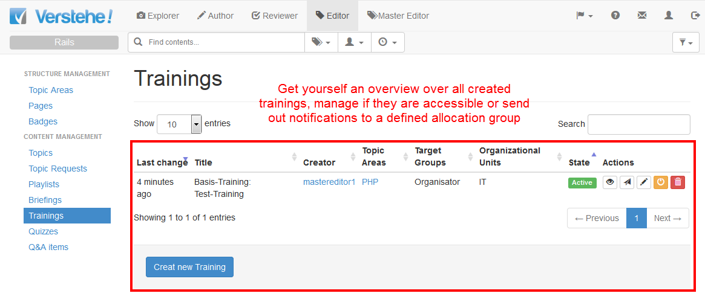
Editing – Functions: Topic Editing (Example)

Slide 73
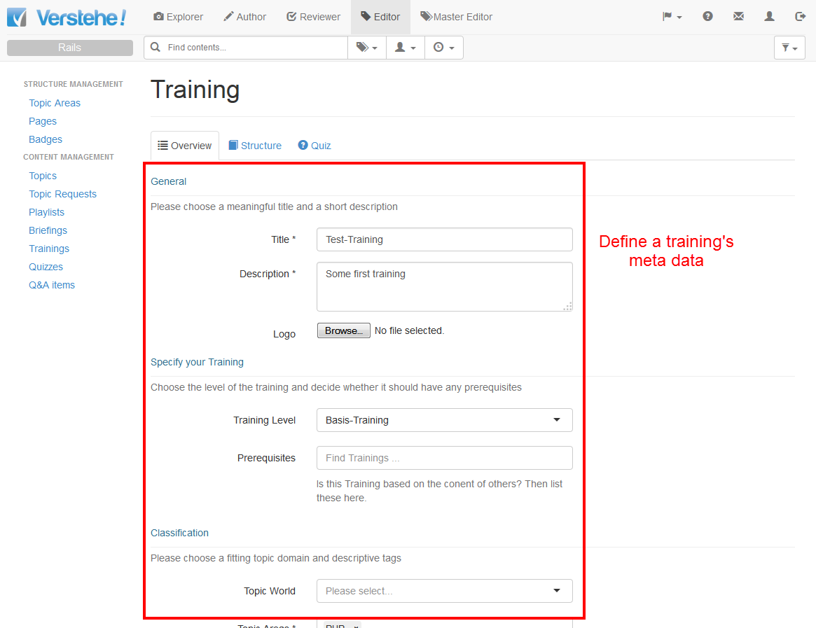
Editing – Functions: Topic Editing (Example)

Slide 74
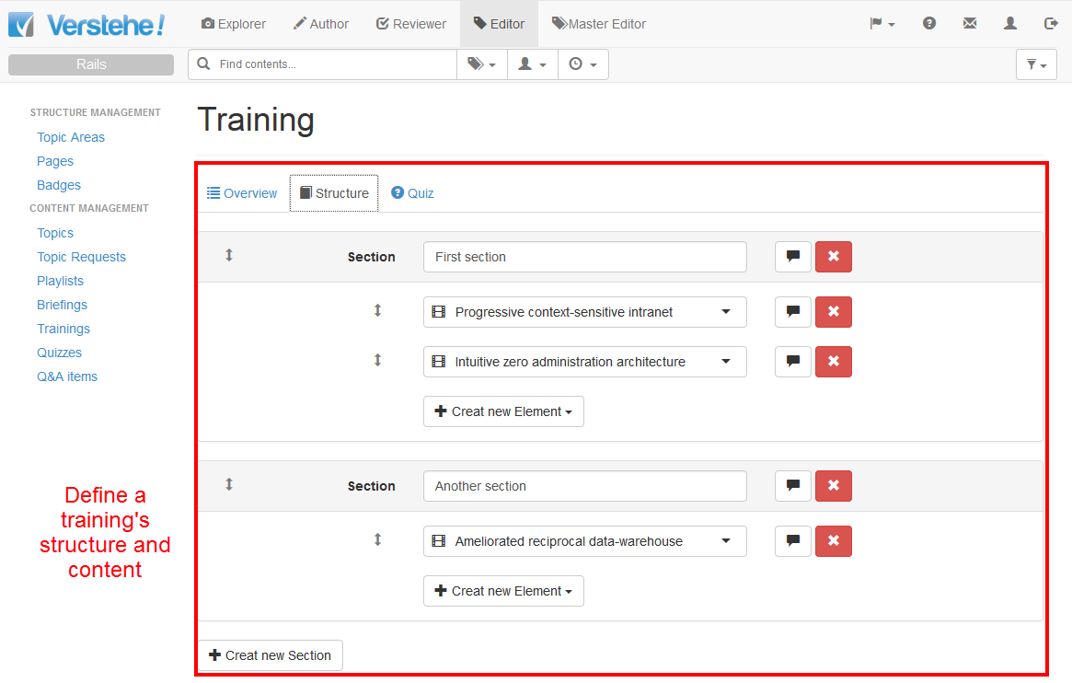
Editing – Functions: Topic Editing (Example)

Slide 75
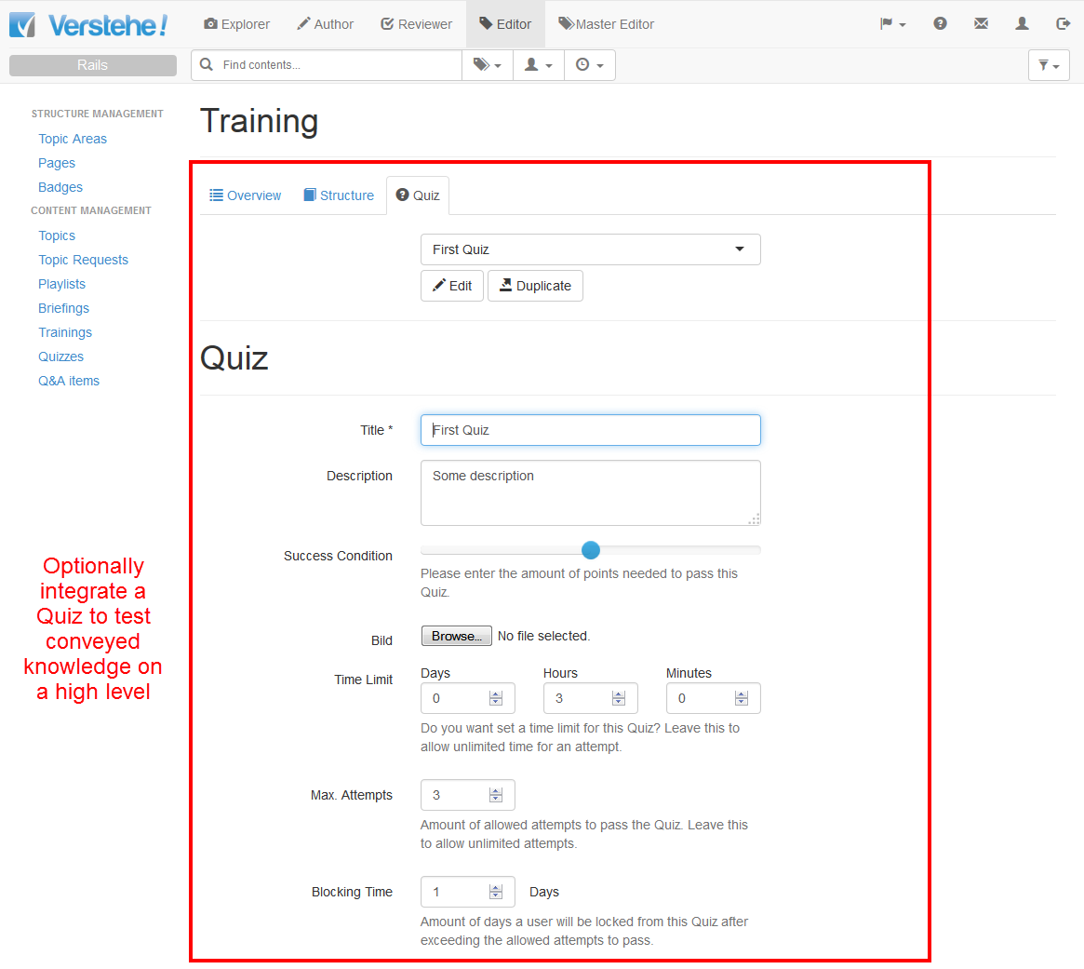
Editing – Functions: Topic Editing (Example)

Slide 76
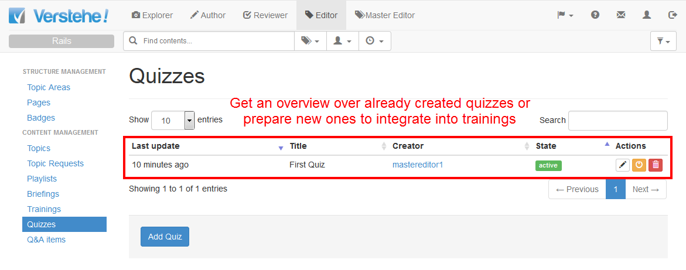
Editing – Functions: Topic Editing (Example)

Slide 77
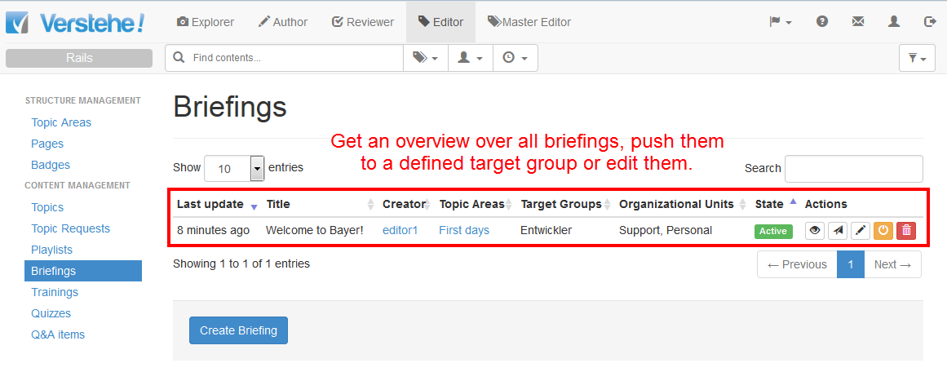
Editing – Functions: Topic Editing (Example)

Slide 78
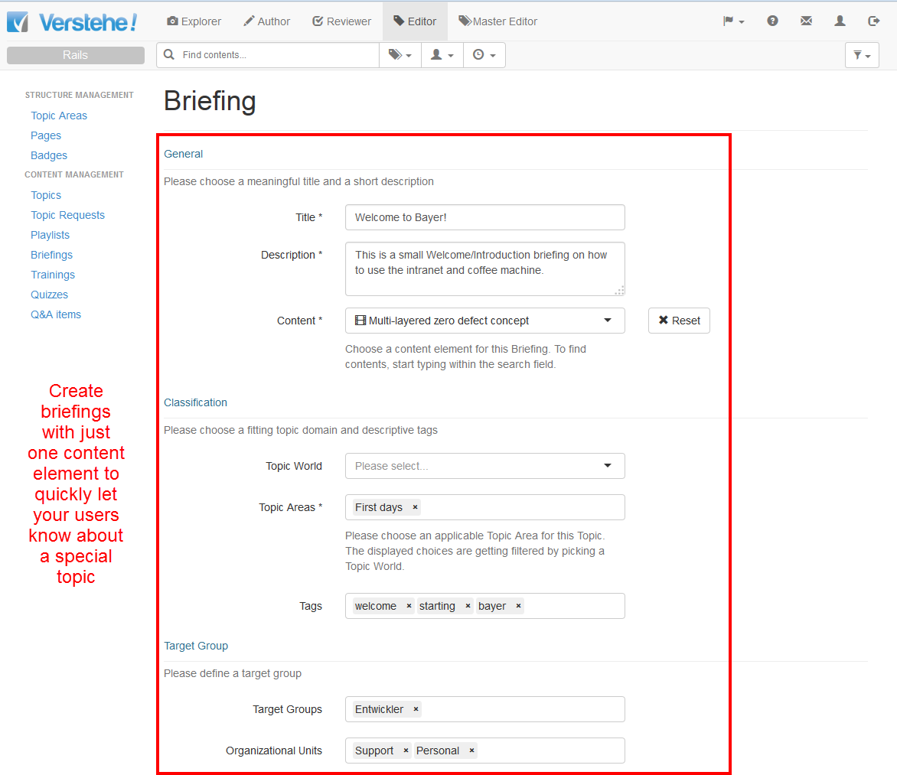
Editing – Functions: Topic Editing (Example)

Slide 79
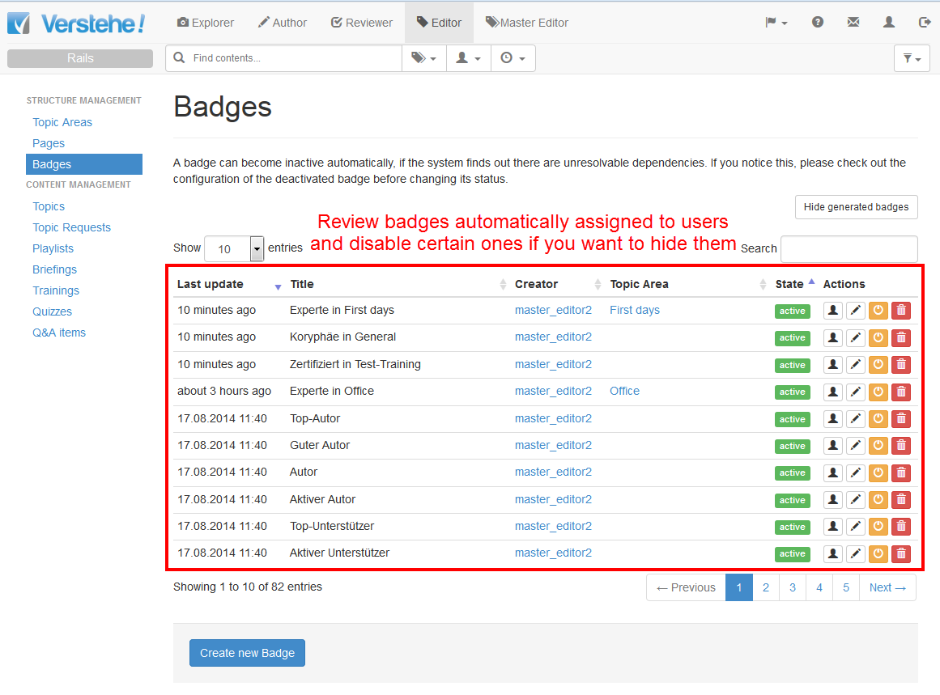
Editing – Functions: Topic Editing (Example)

Slide 80
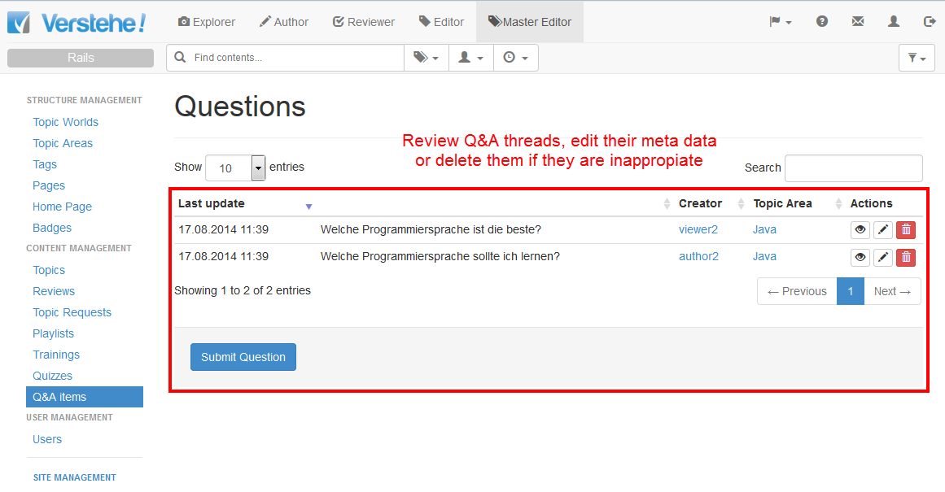
Editing – Functions: Master Editing (Example)

Slide 81
Editing – Functions: Master Editing
All Functions from Topic Editing and:
Topic Worlds: Dashboard, Create/Read/Update/Delete Actions
Tags: Dashboard, Create/Read/Update/Delete Actions
Home Page: Create/Read/Update/Delete Actions
Reviews: Dashboard
Users: Dashboard, Create/Read/Update/Delete Actions

Slide 82
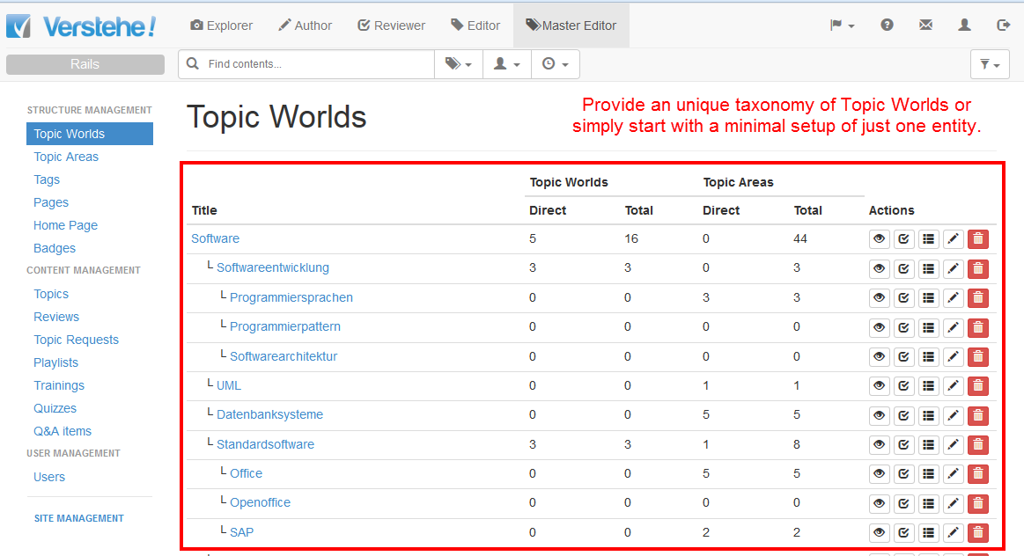
Editing – Functions: Master Editing (Example)

Slide 83
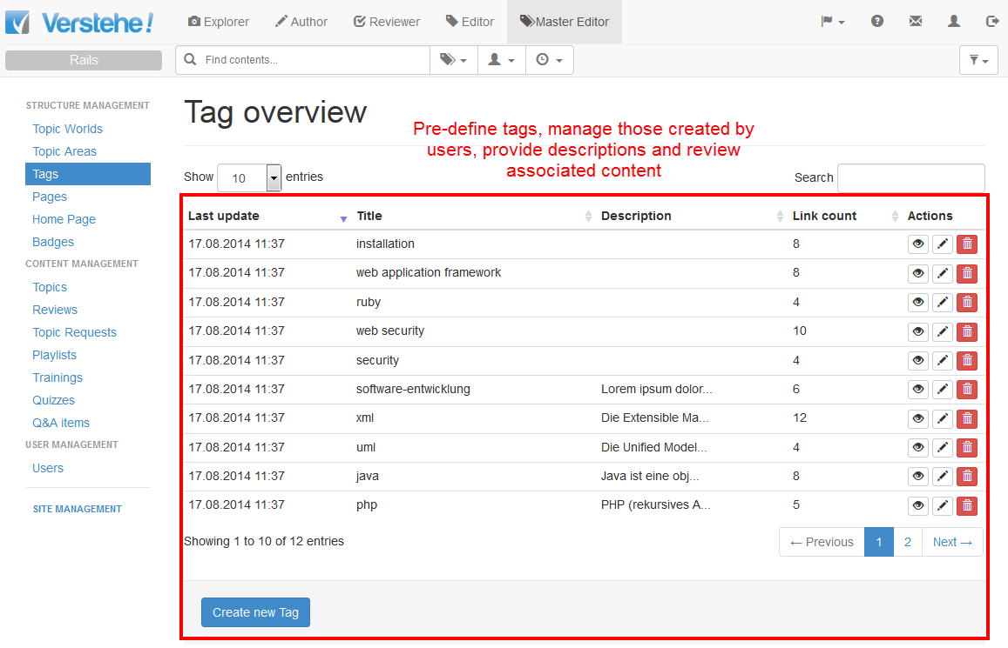
Editing – Functions: Master Editing (Example)

Slide 84
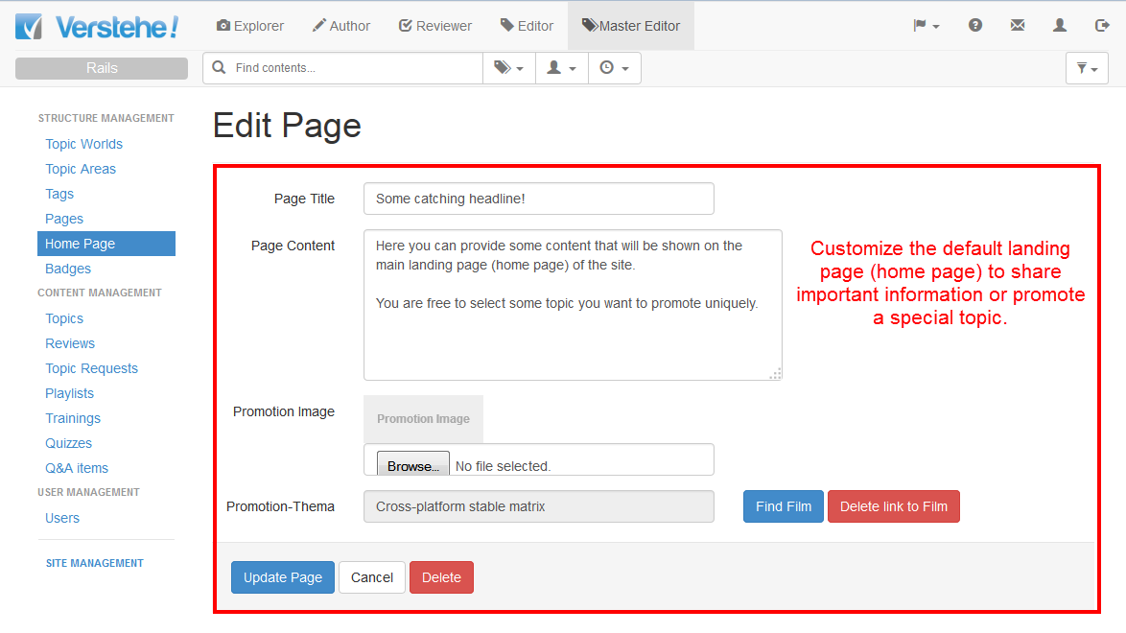
Editing – Functions: Master Editing (Example)

Slide 85
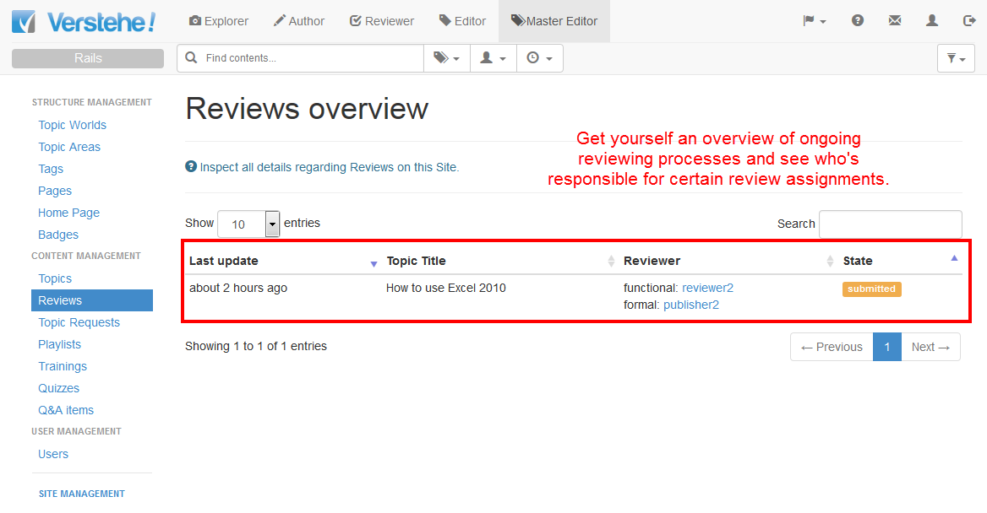
Editing – Functions: Master Editing (Example)

Slide 86
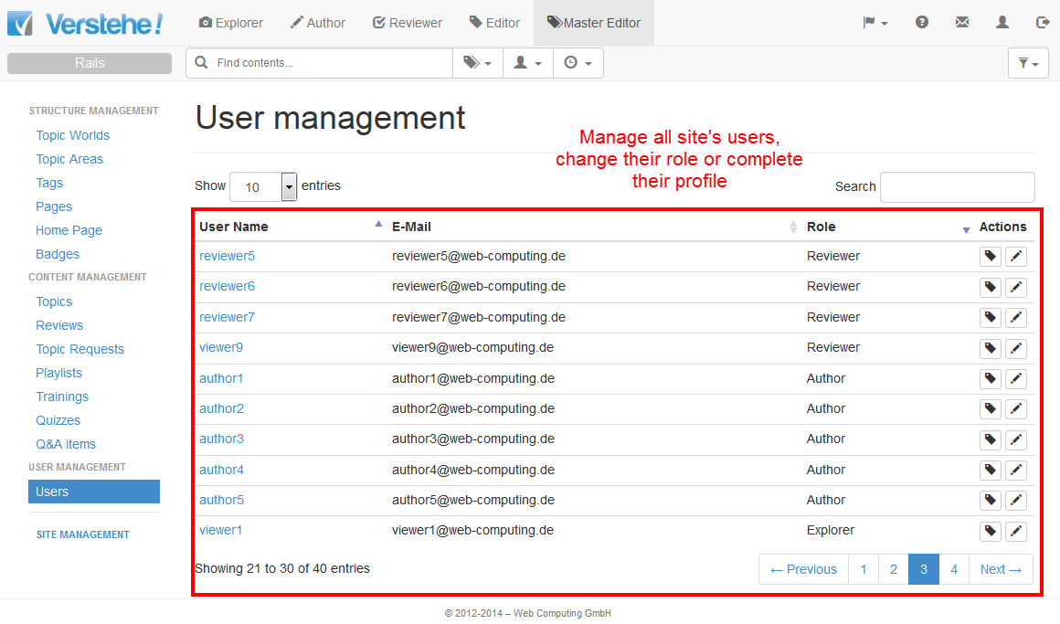
Editing – Functions: Master Editing (Example)

Slide 87
Agenda
1
Product Overview
2
Role & Reputation System
3
Exploring
4
Authoring
5
Editing (ReExploring, Topic Editing, Master Editing)
6
Management (Publishing & Administration)

Slide 88
Management – Functional Aspects

Slide 89
Management – Functions: Publishing
Sites: Dashboard, Create/Update/Delete Actions
Site settings: Dashboard, Create/Update/Delete Actions
Organization: Dashboard, Create/Update/Delete Actions
Target Groups (Enterprise Roles): Dashboard, Create/Update/Delete Actions
Review Schema: Dashboard, Create/Update/Delete Actions
Training Levels: Dashboard, Create/Update/Delete Actions
Film Resolutions: Dashboard, Create/Update/Delete Actions
Users (for your tenant): Dashboard, Update/Delete Actions
Roles: Dashboard, Assign/Update/Delete Actions
Reputation Schema: Update Actions

Slide 90
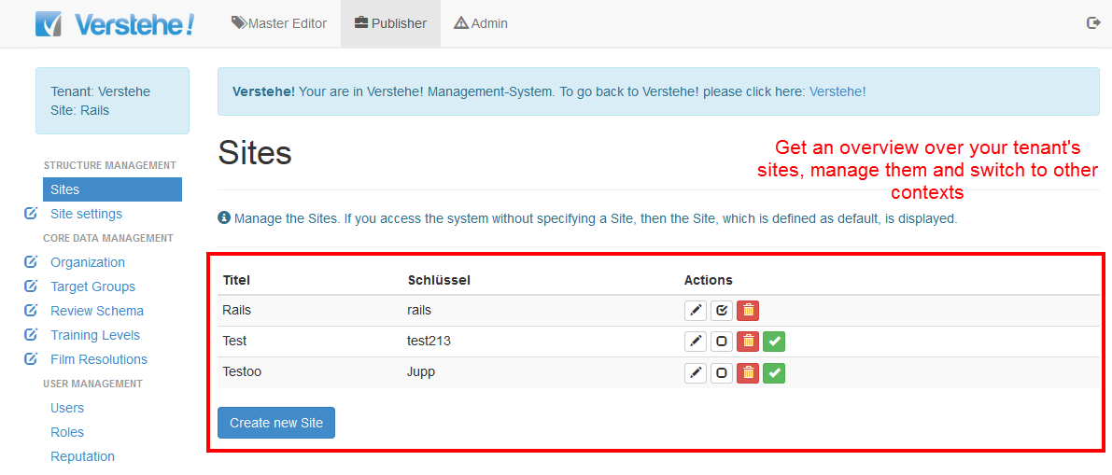
Management – Functions: Publishing (Example)

Slide 91
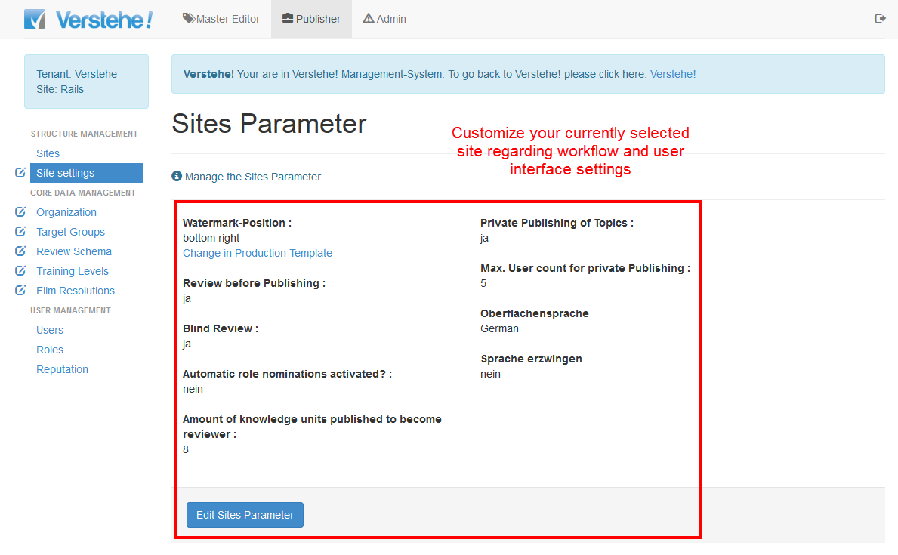
Management – Functions: Publishing (Example)

Slide 92
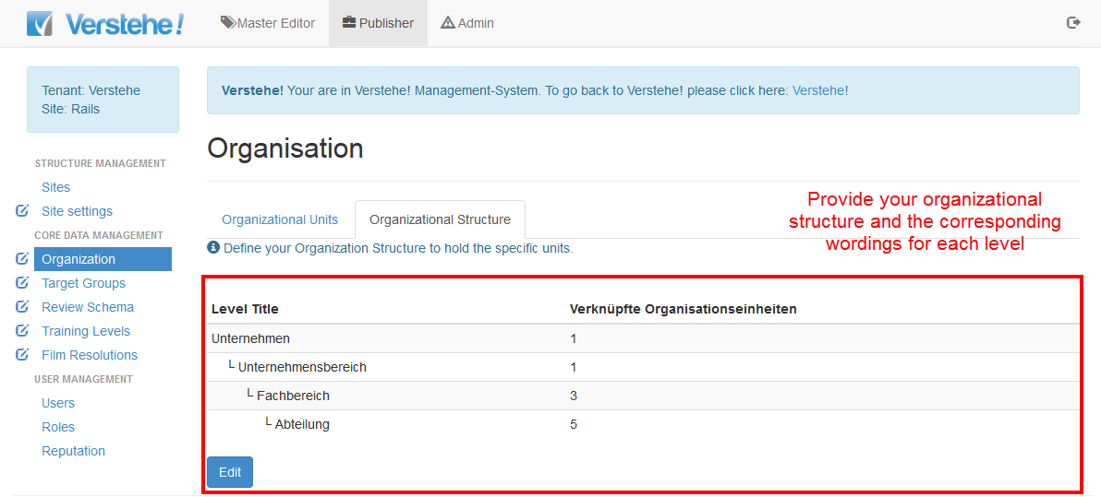
Management – Functions: Publishing (Example)

Slide 93

Management – Functions: Publishing (Example)

Slide 94

Management – Functions: Publishing (Example)

Slide 95


Management – Functions: Publishing (Example)

Slide 96

Management – Functions: Publishing (Example)

Slide 97

Management – Functions: Publishing (Example)

Slide 98

Management – Functions: Publishing (Example)

Slide 99

Management – Functions: Publishing (Example)

Slide 100

Management – Functions: Publishing (Example)

Slide 101
Management – Functions: Administration
Tenants: Dashboard, Create/Update/Delete Actions
Production Templates: Dashboard, Create/Update/Delete/Activate Actions
Users (for your tenant): Dashboard, Update/Delete Actions
System Parameter: Dashboard, Create/Update/Delete Actions
Media Production Monitor: Dashboard, Create/Update/Delete Actions

Slide 102

Management – Functions: Administration (Example)

Slide 103

Management – Functions: Administration (Example)

Slide 104

Management – Functions: Administration (Example)

Slide 105

Management – Functions: Administration (Example)

Slide 106

Management – Functions: Administration (Example)

Slide 107
Kernfunktionen
Notes:
Herausgeber-Funktionen
Chefredakteur-Funktionen
Fachredakteur-Funktionen
Erweiterte Autor-Funktionen (Dokumenten- und Quelltext-Bereitstellung)
Erweiterte Recording-Funktionen (u.a. Auswahl Mikrofon, Maushervorhebung)
Erweiterte Administrationsfunktionen
Embed-Funktion
Notification-Funktion
Multi-Instanz-Fähigkeit (noch nicht vollautomatisiert)

Slide 108



Contacts
Prof. Dr. Wolfgang Wicht
Partner
Mail ww@web-computing.de
Mobile +49 177 9721441
Maximilian Busch, B. Sc . MIS
CEO
Mail mb@web-computing.de
Phone +49 251 39655243
Mobile +49 151 54777070
Sebastian Zimmermann, B. Sc. MIS
CEO
Mail sz@web-computing.de
Phone +49 251 39655243
Mobile +49 177 6563083

